Slide 1



Zakendoen in China
Trends en Opportuniteiten
E-commerce & Social Media
Missie China 14-21 oktober 2017
29 August 2017

Slide 2


Agenda
Introduction Horsten International
China today
Strategic considerations
E-commerce business models
Social Media in China

Slide 3

Bart Horsten
  China Entrepreneur and Consultant since 1998, focusing on assisting Western SMEs in doing business in China
  Managing Director of HORSTEN International, a company with more than 35 years of experience in China and offices in Belgium and China
  Founding Partner of MyChinaWeb, the first China online marketing agency in Belgium
  Shareholder and Board member of several China/Hong Kong ventures

Slide 4


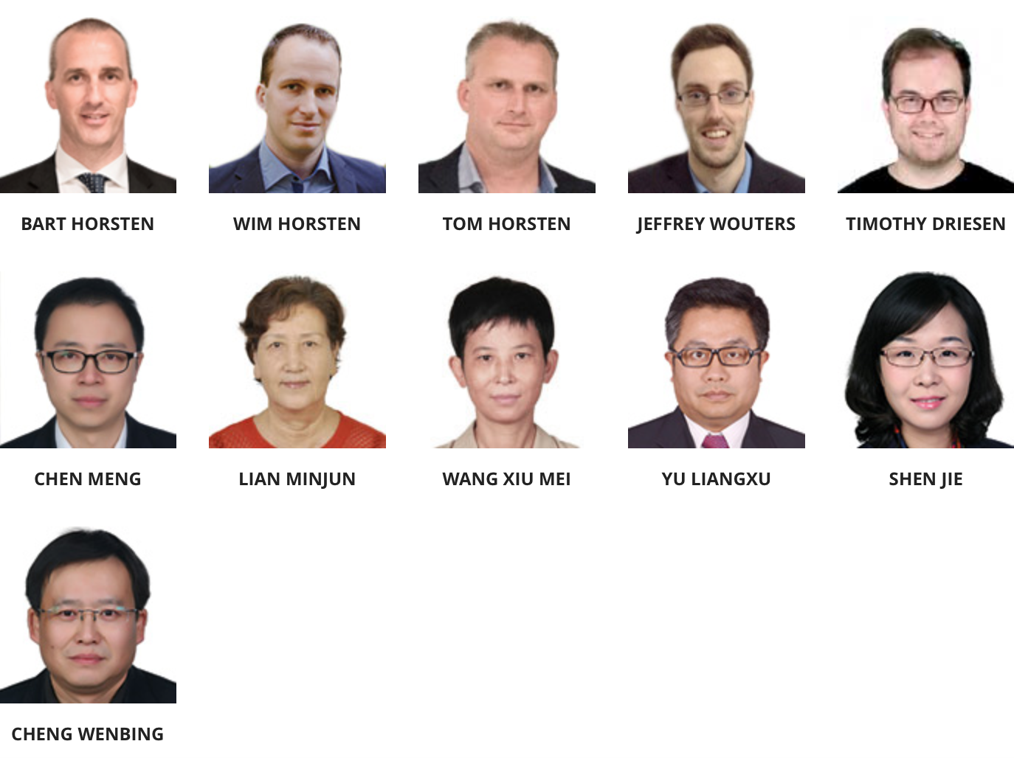
Established in 1996 by Joos Horsten (former VP International Janssen Pharma - part of Johnson & Johnson - and ‘founding father’ of the successful Xian-Janssen Joint Venture, the 1st pharma JV in China in the ’80s)
Headquartered in Oud-Turnhout (Antwerp)
Two 100% affiliates (in Hong Kong and China)
Family-owned with 11 employees
100% focus on China

Slide 5






China Services
Services
CHECK OUT OUR WEBSITE
www.horsten.be

Slide 6
















































Project References

Slide 7
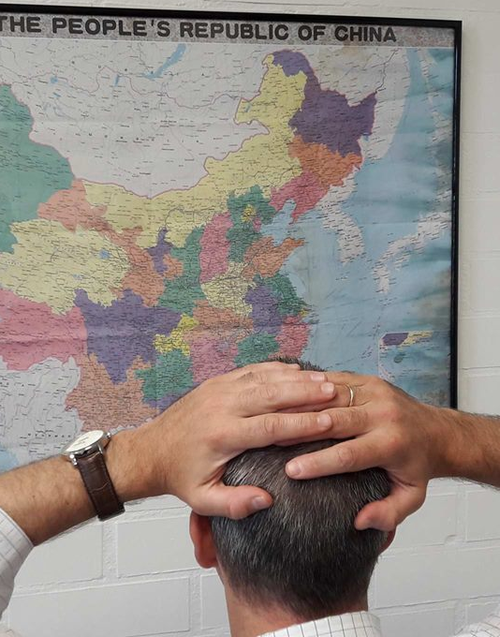
Meet the Frustrated China Export Manager!

Slide 8

Commitment!

Slide 9
China Today

Slide 10
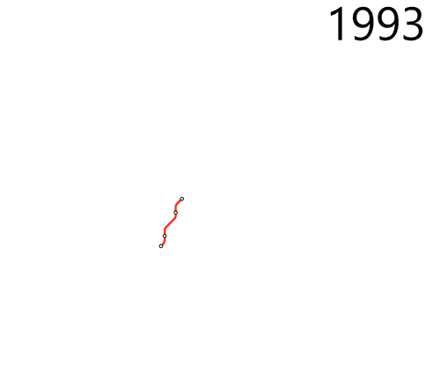
Metro Shanghai

Slide 11
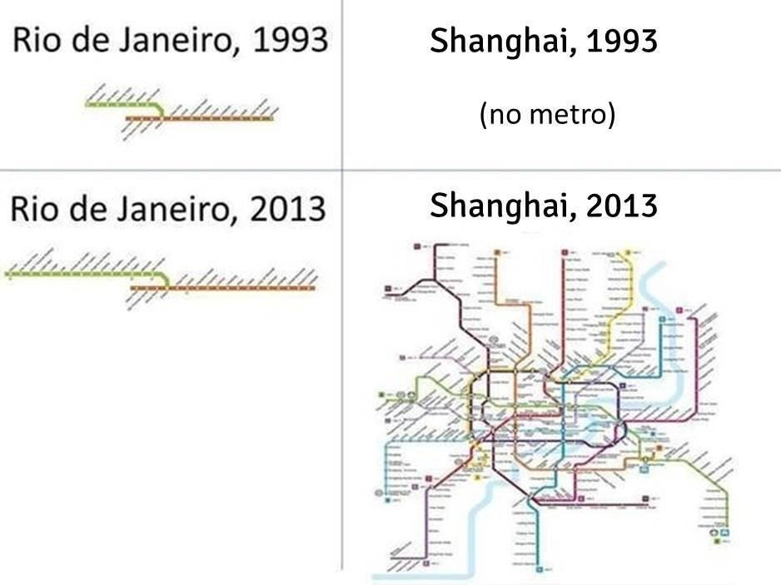

Slide 12
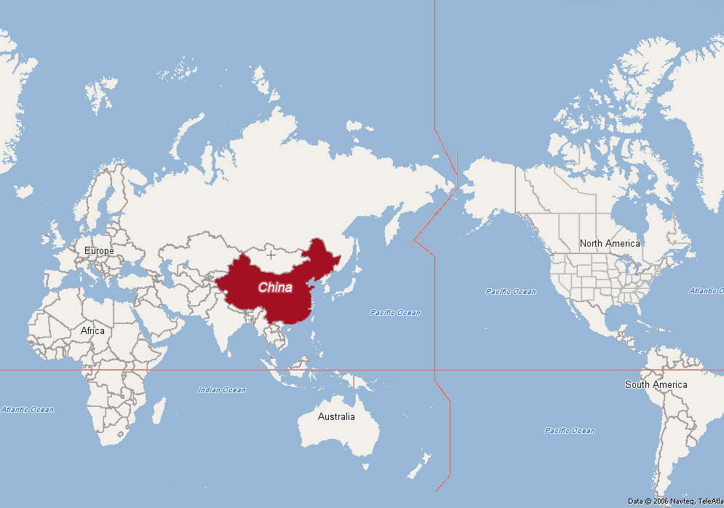
The Chinese World Map

Slide 13
4 RECENT YEARS’ TENDENCIES:
GO HIGHER
GO WEST
GO DIGITAL
GO GLOBAL

Slide 14
Moving up the Value Chain
“Made in China 2025”
High
Big and sophisticated (export) market
Acquired by China
Branded in China
Sold in China
Production costs
Low cost
production basis
Test ground
for new business concepts
Made in China
Designed in China
Low
Little
Market size
Big
Source: Prof.Zhang Haiyan, Antwerp Management School

Slide 15
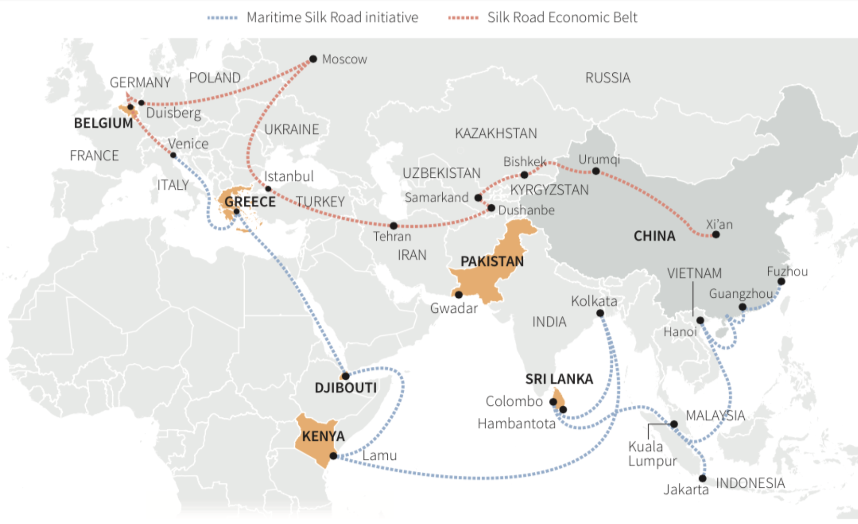
”One Road One Belt”: China’s new Silk Road

Slide 16
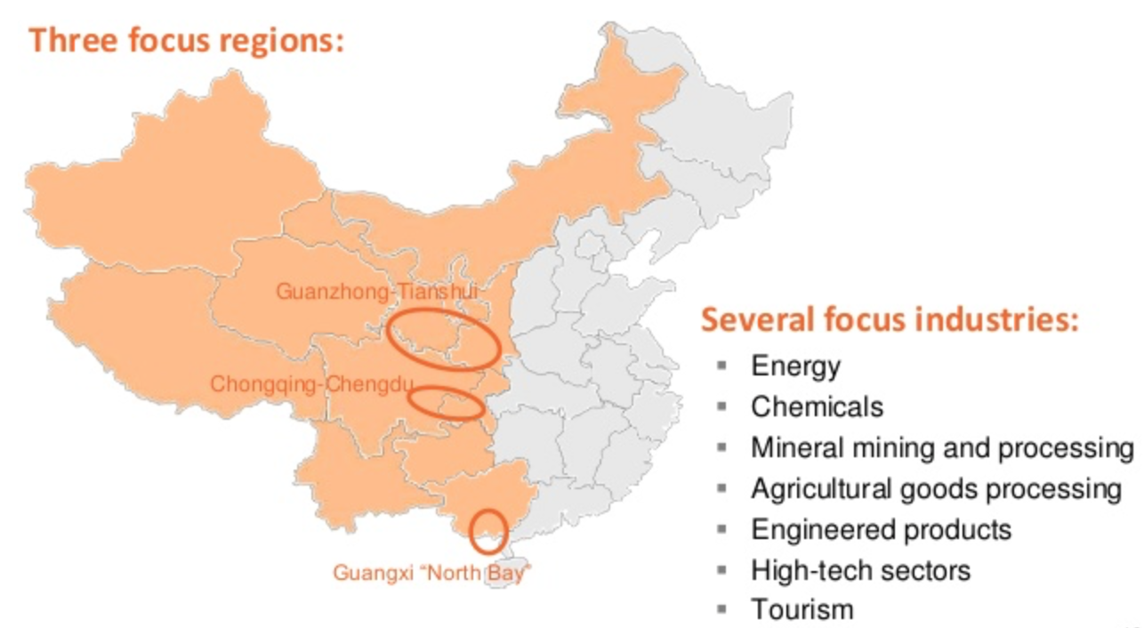
Go West: Opportunities in 2nd & 3rd tier cities

Slide 17











Go Global
Famous Chinese global brands

Slide 18
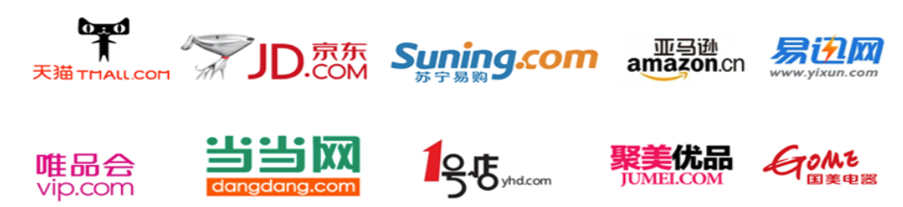

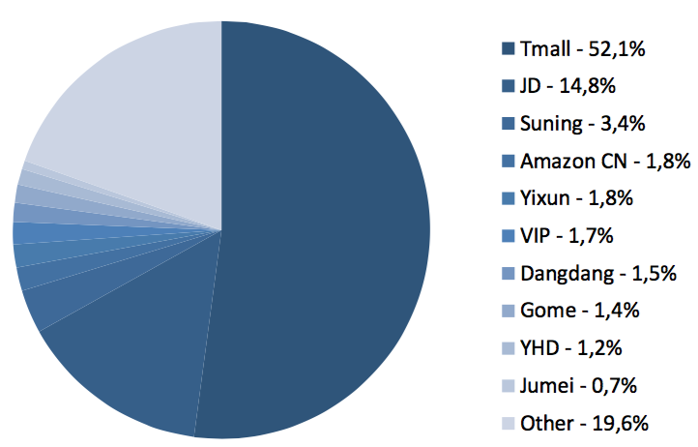
Go Digital
China’s e-commerce and social media is booming; today China already is the biggest e-commerce market in the world

Slide 19
Strategic Considerations

Slide 20

Strategic Considerations
Have a
strategy!

Slide 21

Strategic Considerations
Think Online & Offline!

Slide 22

Strategic Considerations
Stay in Control!

Slide 23
Strategic Considerations
Localization!

Slide 24

Strategic Considerations
Flexibility!

Slide 25
Strategic Considerations
Commitment!

Slide 26
E-commerce & Social Media in China

Slide 27

Introducing MyChinaWeb

Slide 28
Services
Online Marketing
E-Commerce
Chinese Web Design
Social Media
Content Management
www.mychinaweb.com

Slide 29
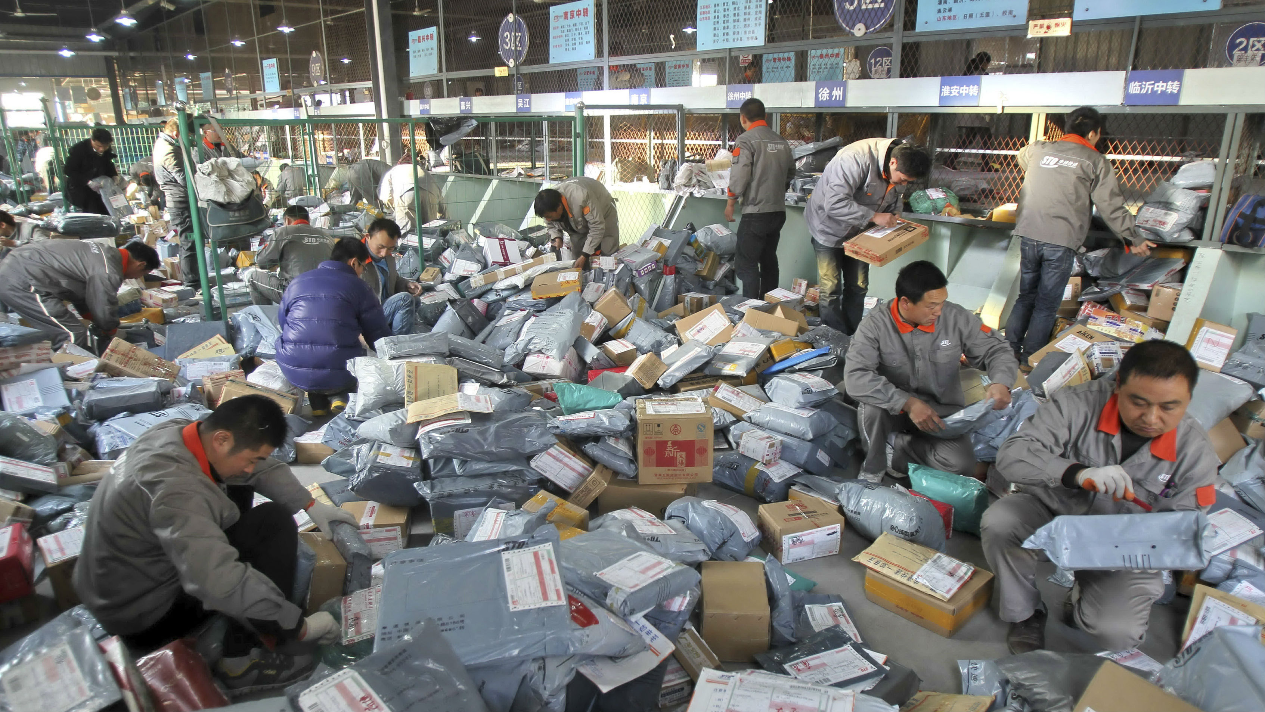
“Bricks-and-mortar retailing is a mature business in the U.S., where consumers have been shopping in malls for decades and continue to do so, augmenting their purchases with occasional forays on the web. Online shopping is dessert in the U.S., but in China, it is the main course.”
Jack Ma, Group Founder and Chairman, Alibaba

Slide 30
China’s Internet Users
53,2% penetration
95% mobile internet

Slide 31


China: the Dreamplace for E-commerce!
The “overlap” between the population on social media and brand consumers is much bigger than in the west
Chinese people are massive creators of content, while most western people are passive spectators
Chinese people are very open to new technologies and experiences

Slide 32

The ‘BAT’tle between the 3 major players

Slide 33
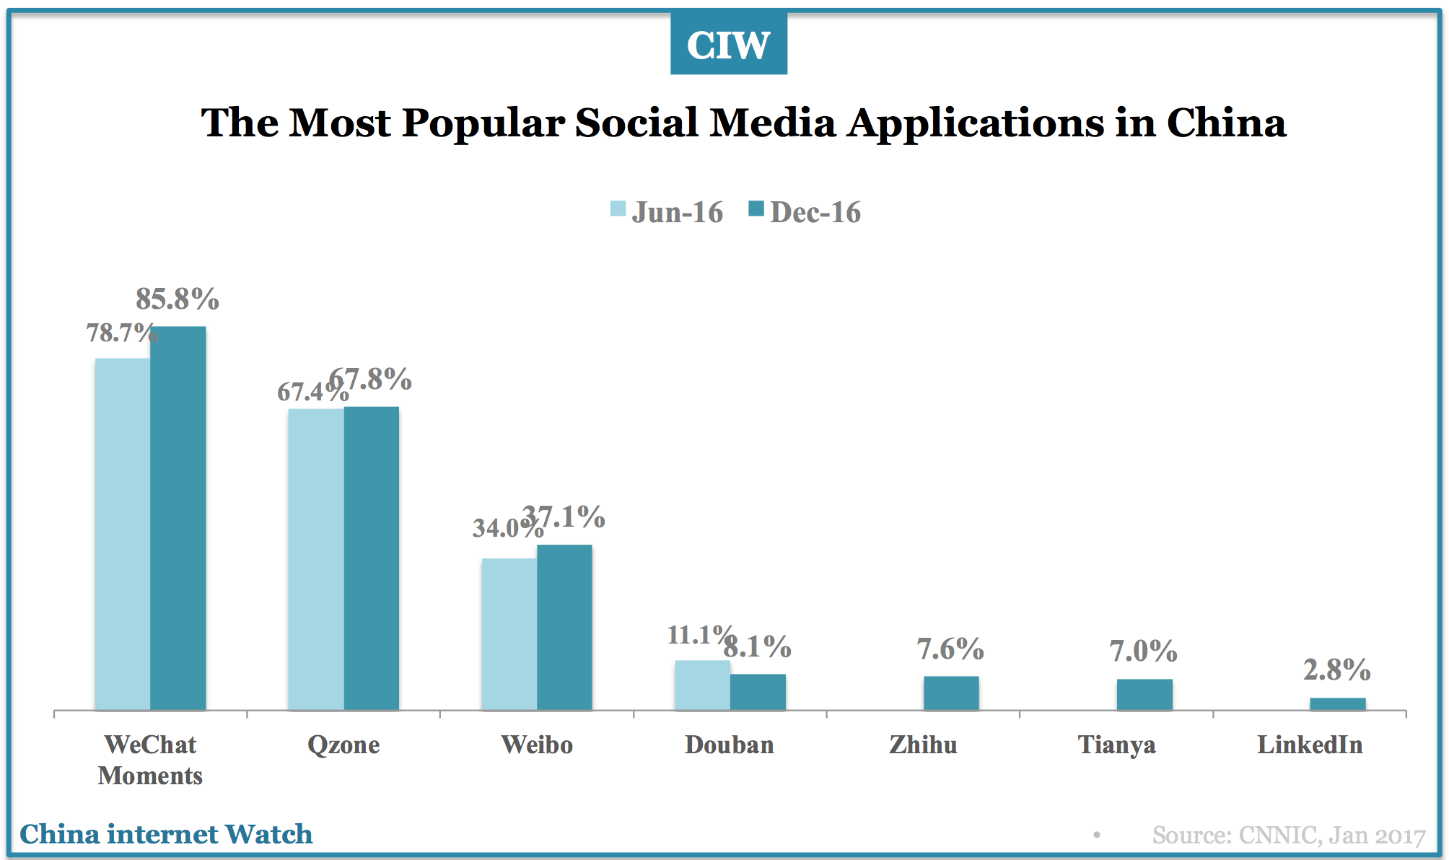

Slide 34
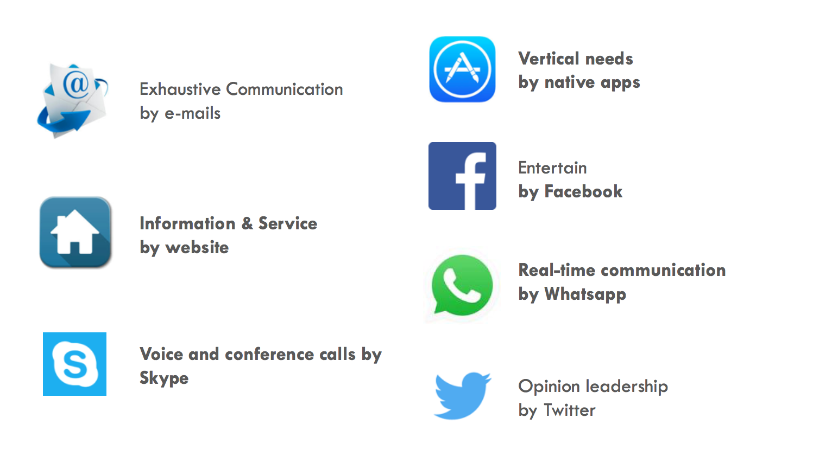
Internet as we got to know it

Slide 35

A western smartphone

Slide 36
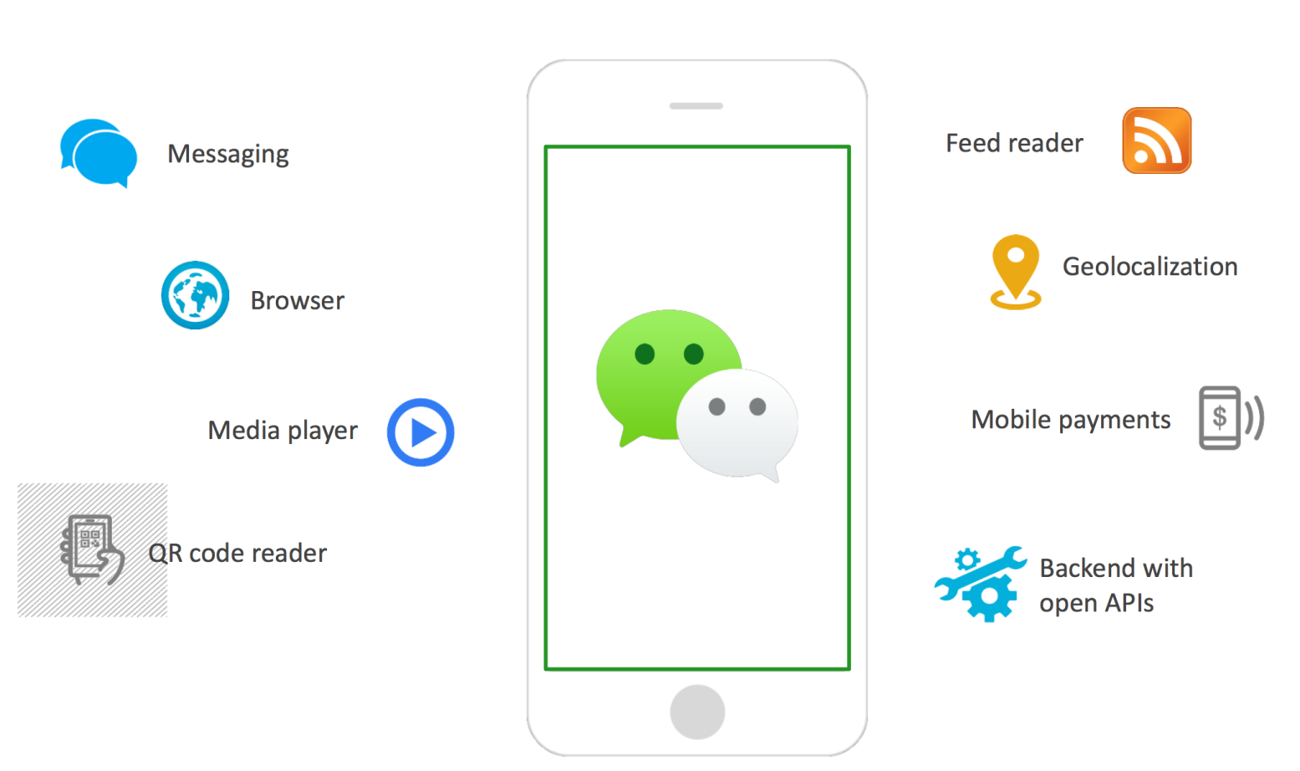
WeChat allows integrated access to almost all digital services

Slide 37
What is ‘WeChat’?
Originally a messaging app
Owned by Tencent (one of the ’BAT’ players)
> 800 million MAU globally (most popular messaging app in China)
Closed social network
Personal accounts and company accounts
All-in-one app: WeChat Wallet; games; shopping; taxi; train tickets, etc.

Slide 38
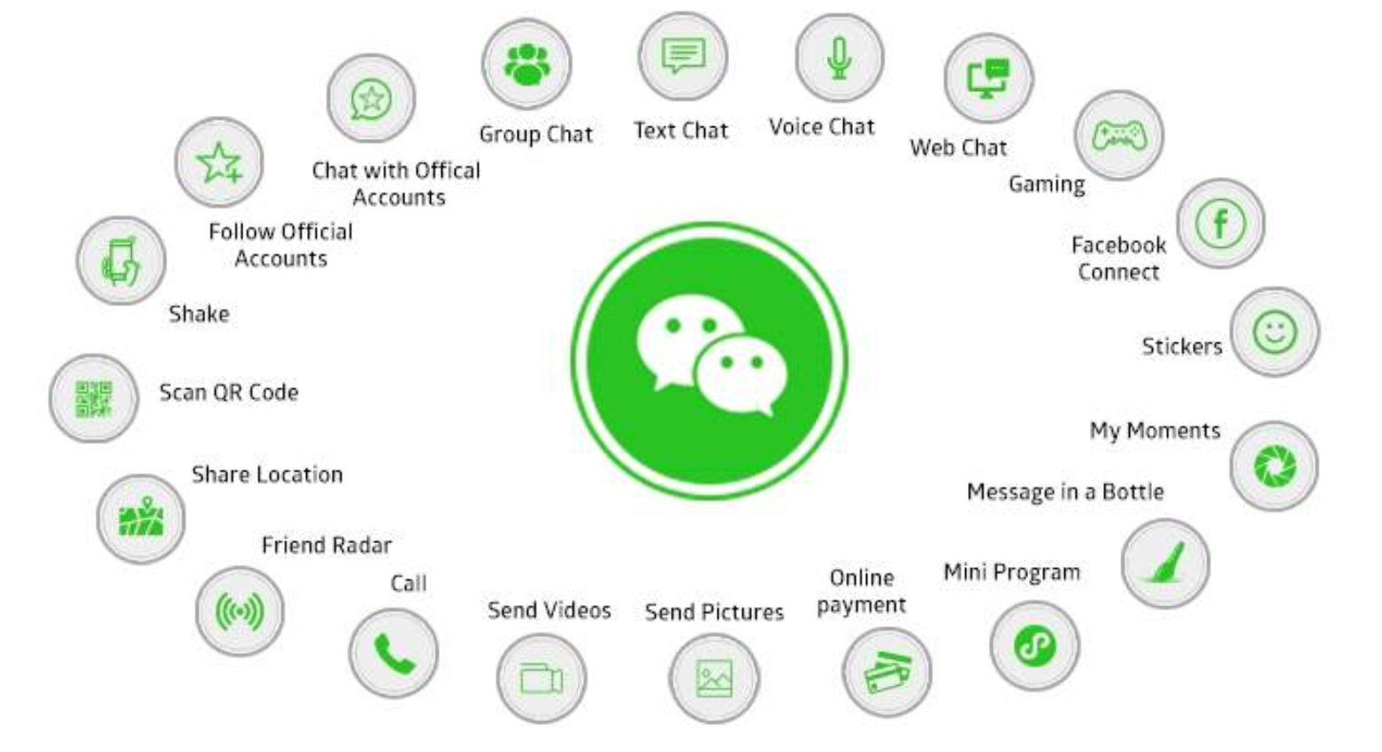
WeChat: the one-stop-shop for Chinese netizens

Slide 39
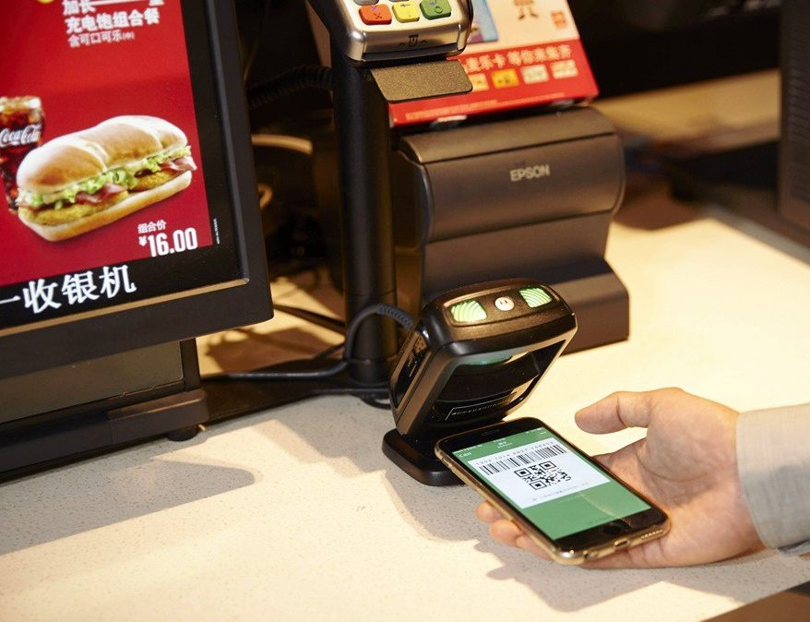
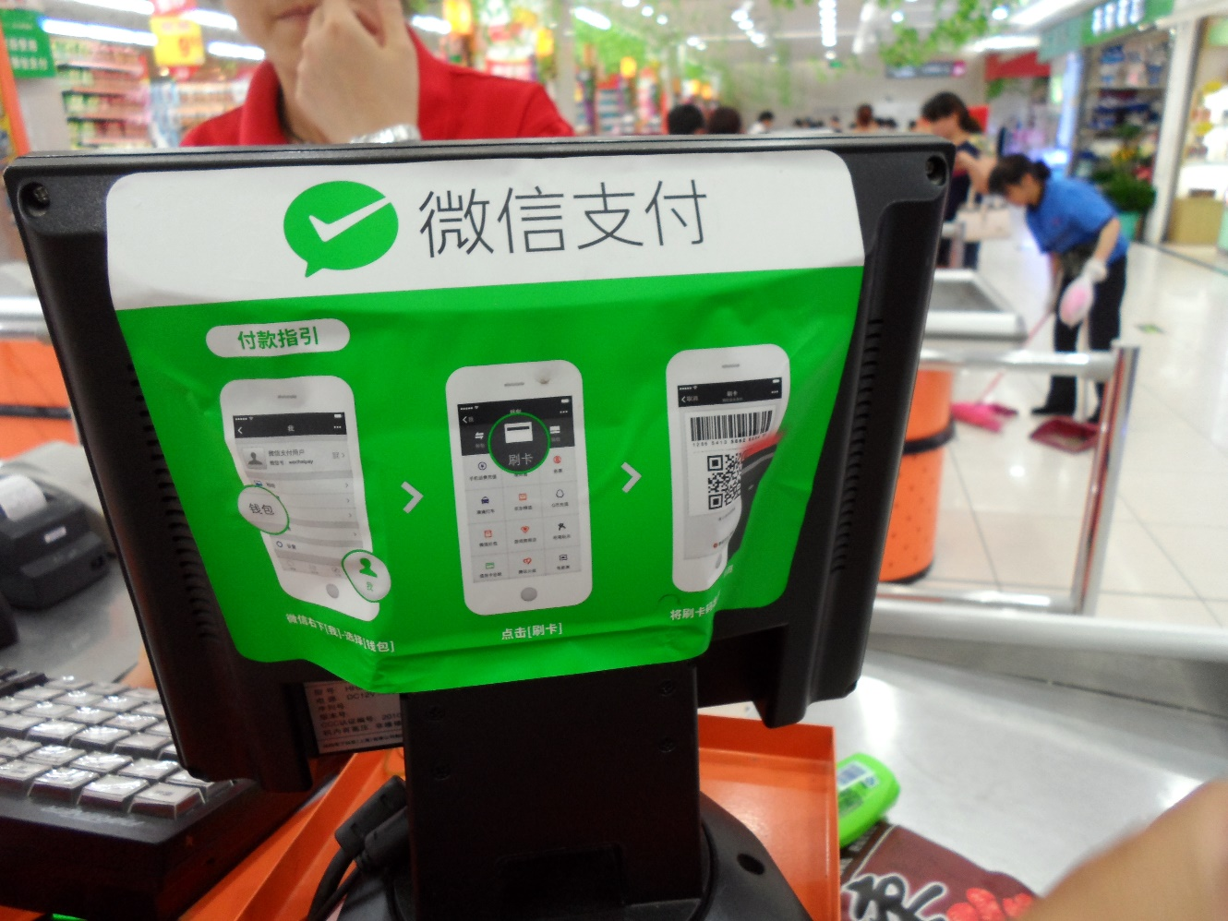
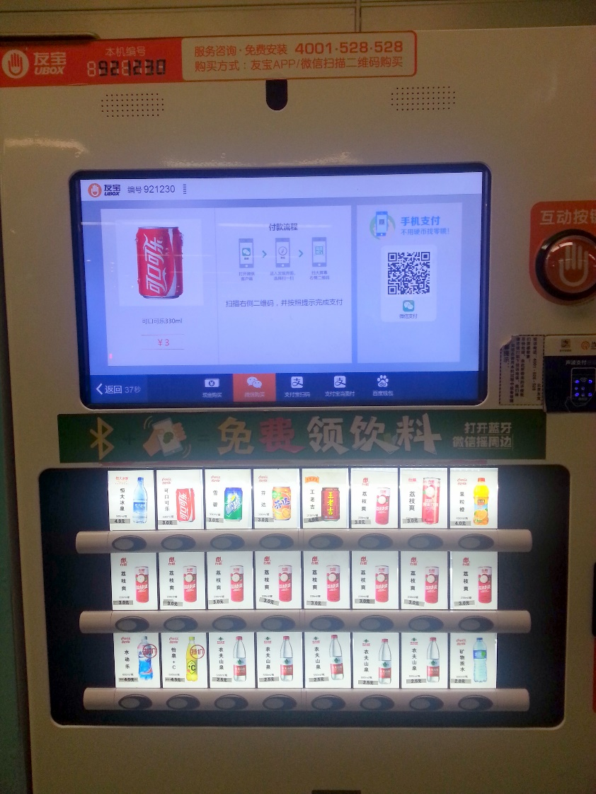
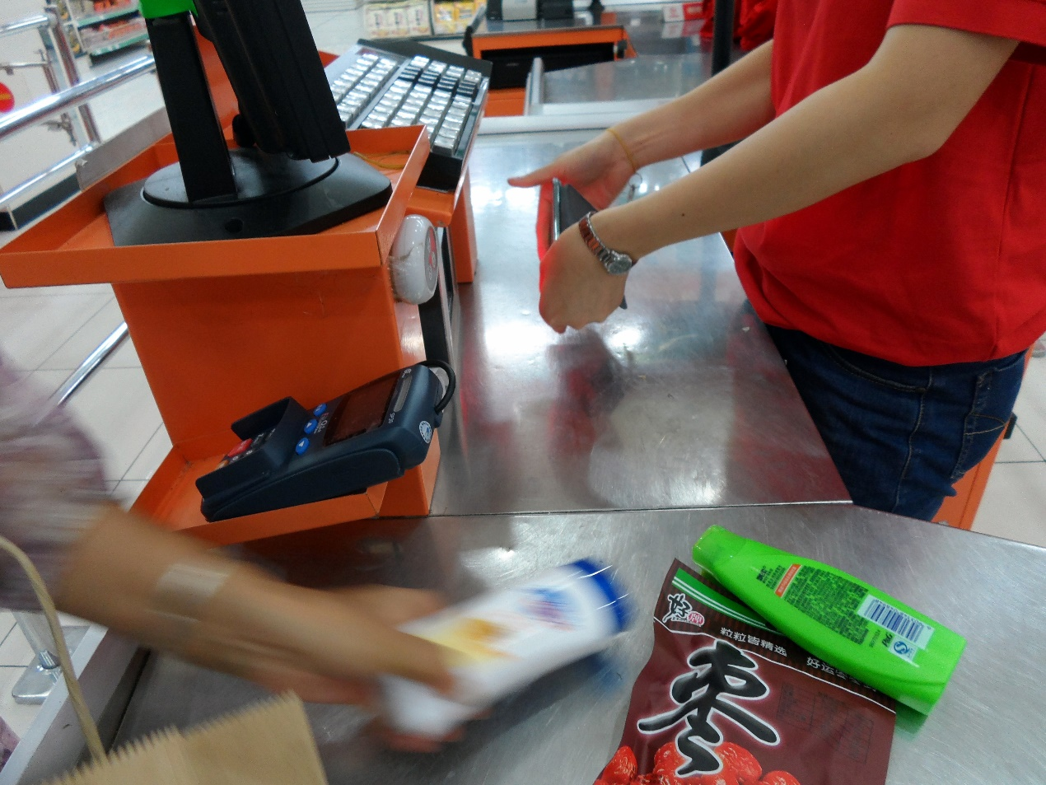

Slide 40
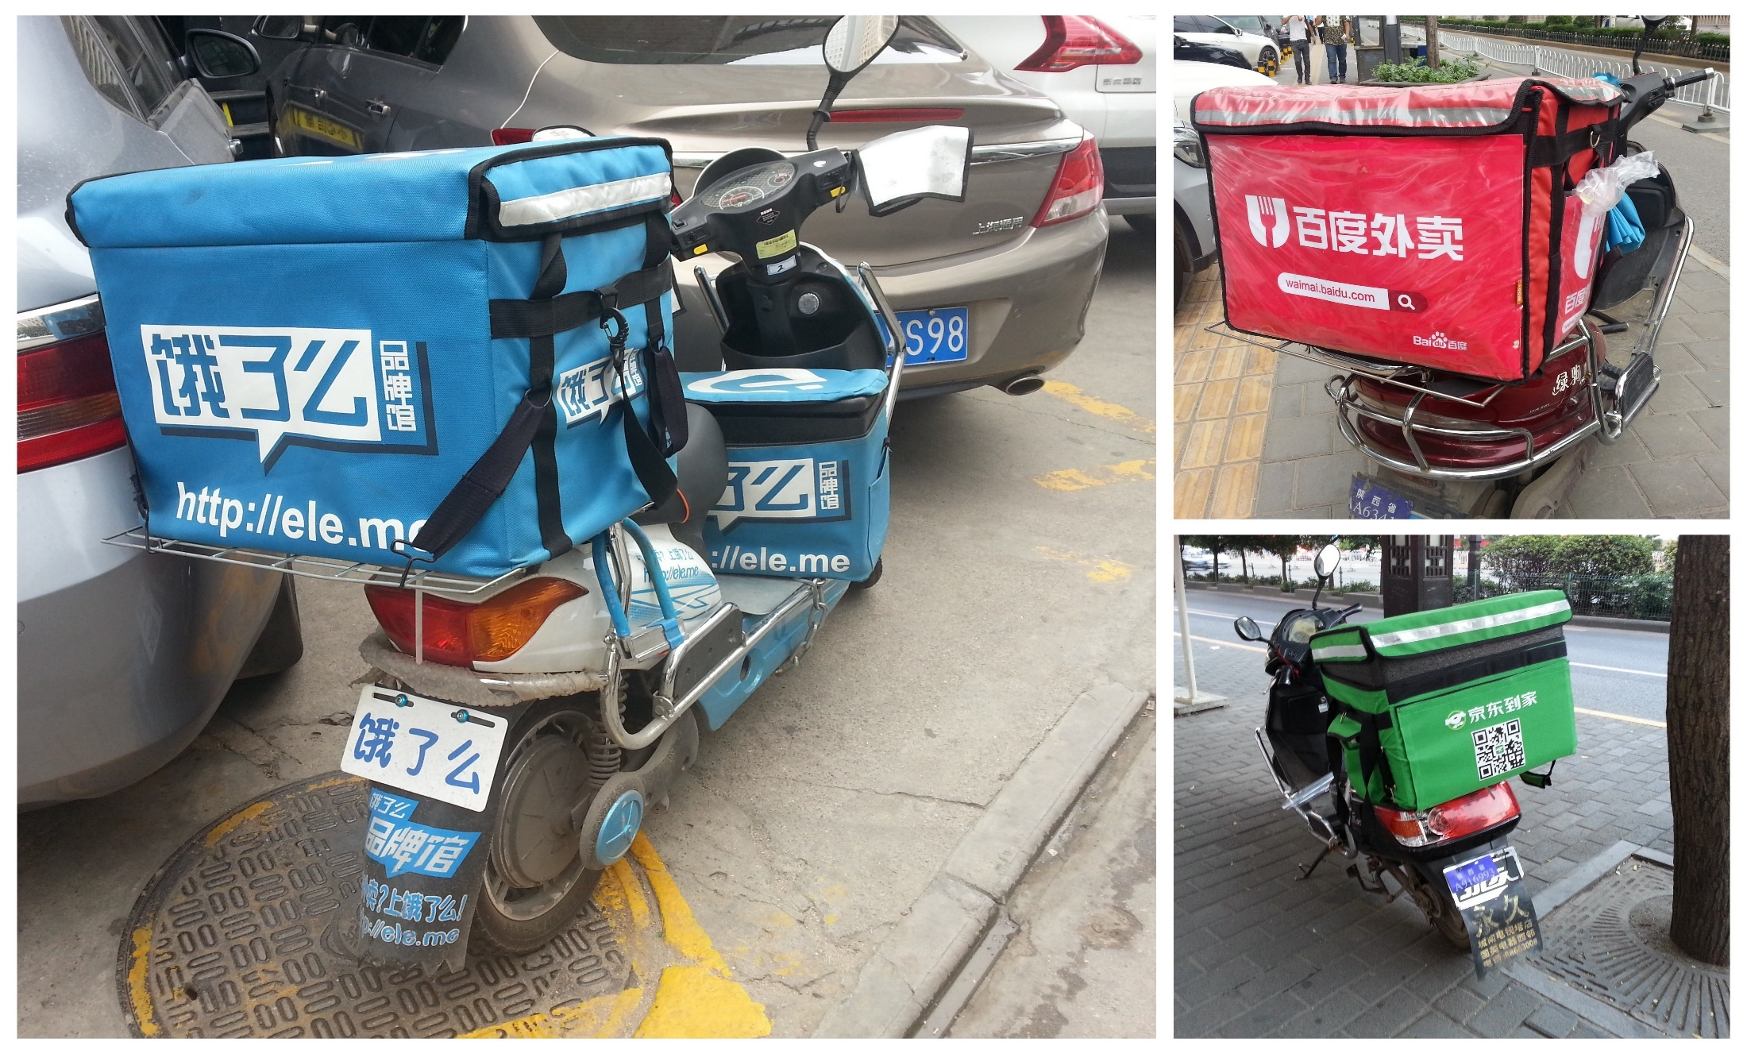

Slide 41
E-commerce Business Models
Webshop in China
Your own webshop in China
(Direct to Consumer)
Third Party Platforms
WeChat Store
Cross border
direct from foreign website
via third party platform
WeChat Cross-Border Store

Slide 42
E-commerce Business Models
Webshop in China
Your own webshop in China
(Direct to Consumer)
Large investment required
Website hosted in China
Highest level of control
Third Party Platforms
Most effective channel to reach Chinese shoppers
Requires commitment and investment
Local entity or trusted partner needed

Slide 43
E-Commerce in China
Most popular products:
Mother & baby products
Cosmetics and personal care products
Food & beverages
Health products
Household daily consumables
Fashion (clothes, shoes, bags)

Slide 44
Chinese E-commerce Platforms
and many others…
China-registered companies only (often Chinese distributors of foreign brands)
Cash security deposit
Annual subscription fee
Commission on each transaction
Work with designated logistic partners
Invest in marketing

Slide 45




Cross border E-commerce
Western companies without legal entity in China can sell their products directly to Chinese consumers
Low cost/investment
Less regulatory restrictions: positive list with +/- 1300 commodity categories
Reduced taxes
Less traffic than local e-commerce platforms
Partners required for fulfilment/logistics

Slide 46
Cross Border B2C E-commerce
In several cities and some free trade zones and additional qualified cities.
Consumer all accross the country can shop on these platforms
Reasons: to protect consumer interests, strengthen monitoring of product safety, safeguard national tax receipts
All purchases under RMB2000 can enjoy preferential tax rates:
  No duties
  VAT and consumption tax (if any) is reduced to 70% of statutory taxable amounts
The limit for an individual’s yearly transactions is RMB 20.000
Purchases above RMB2000 are governed by the normal tax rates (i.e. VAT and duties)
An individual can apply for tax refunds if imported cross-border e-commerce retail goods are returned within 30 days after customs release

Slide 47
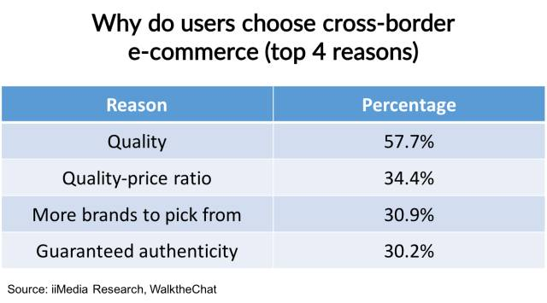
Cross Border B2C E-commerce

Slide 48
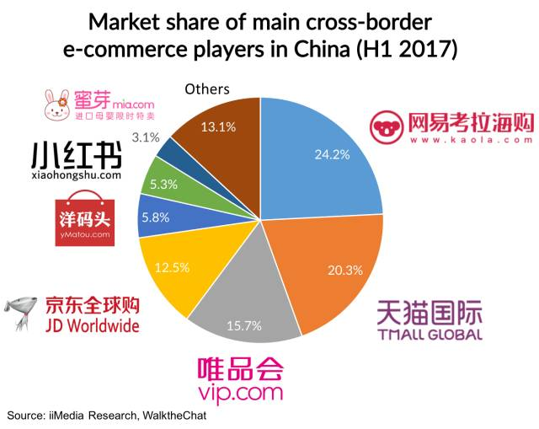
Cross Border B2C E-commerce
The cross-border e-commerce is much more fragmented with no player getting more than 25% of the total market.

Slide 49
Two modes of operation
1. Direct Purchase Import (B2C):
  General principle: order first, delivery later
  Products will only be dispatched from the overseas warehouse upon receipt of the order
  Advantage: the foreign company doesn’t need to take stock in a bonded warehouse in China
  Disadvantage: longer delivery time to customer (2 – 6 weeks) and higher logistic costs

Slide 50
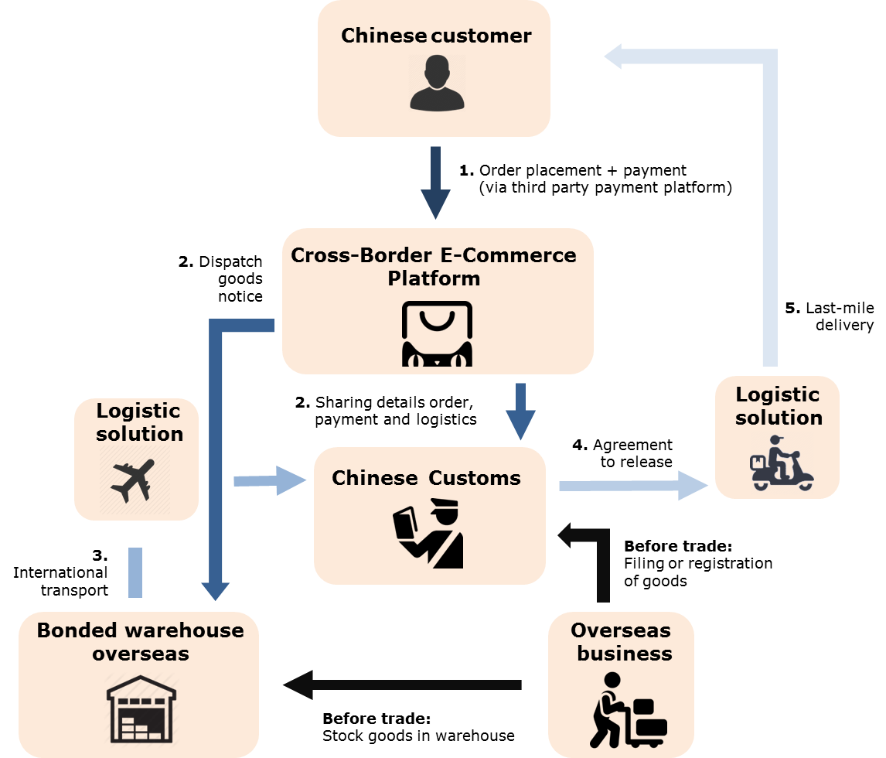

Slide 51
Two modes of operation
2. Bonded import (B2B2C):
  General principle: stock first, order later
  Customs clearance after the consumer places its order on the cross-border e-commerce platform
  Advantage: faster delivery to the customer (within 3-4 days)
  Disadvantage: foreign company has to take stock at the bonded warehouse

Slide 52
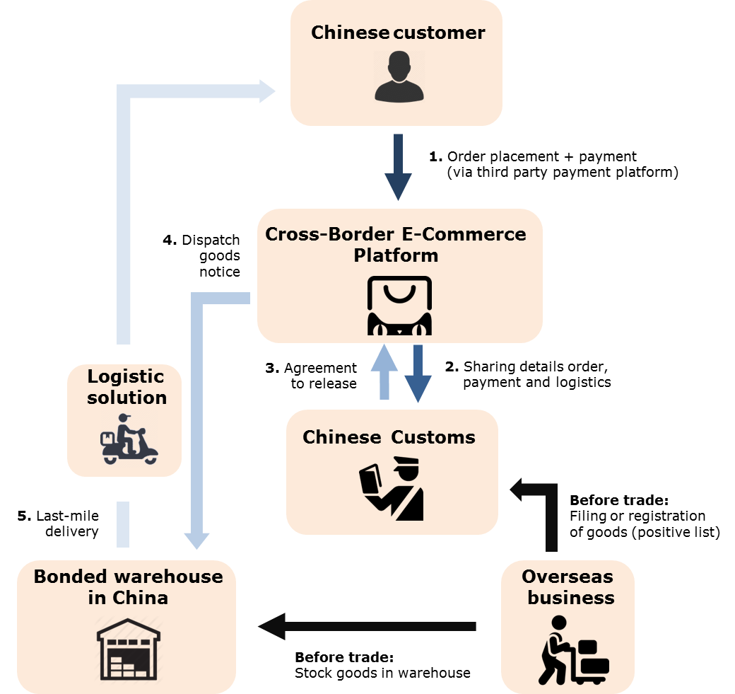

Slide 53
Cross-Border E-Commerce: Heaven on Earth?
Having your brand online in China doesn’t translate into automatic sales
Brands with a strong reputation in Europe may still be unknown in China
You are competing with other Western brands (US, Australian, etc) and increasingly also Chinese competition
Consumer demands in China vary significantly from western consumer demands
Rules and regulations are constantly changing, there are also regional differences, so brands should keep a wait-and-see attitude
Cross-Border E-Commerce should be seen as a low-cost & low-risk first entry into China, but preparations for regular trade and more presence in China should be made from the beginning
Also Cross-Border E-Commerce requires investment in marketing, human resources and commitment

Slide 54
Additional e-commerce models
O2O experience stores
WeChat stores

Slide 55
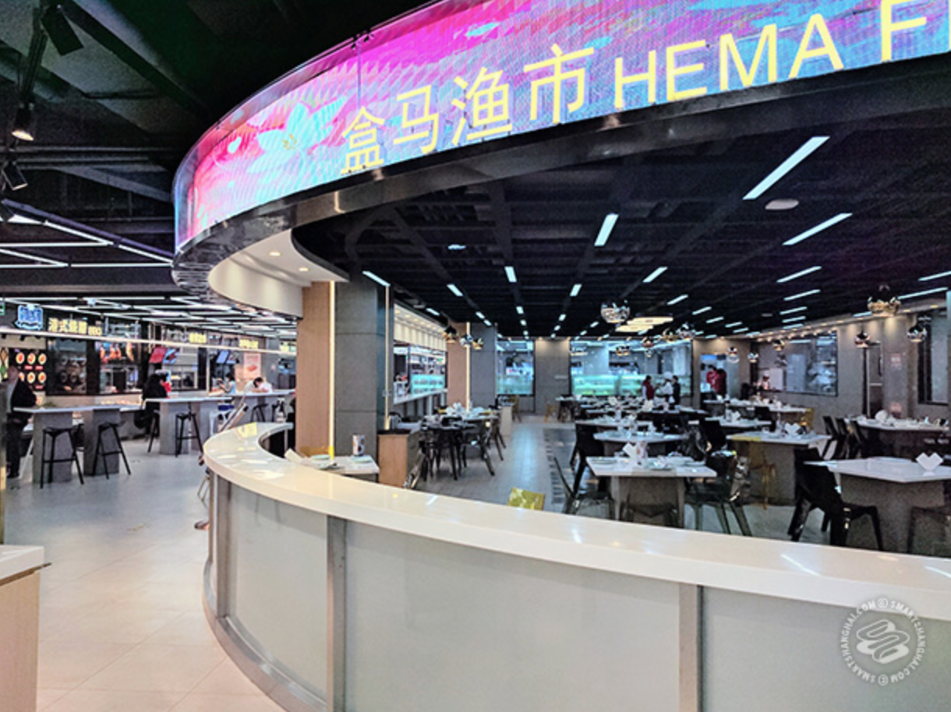
Hema Market (盒马集市)

Slide 56
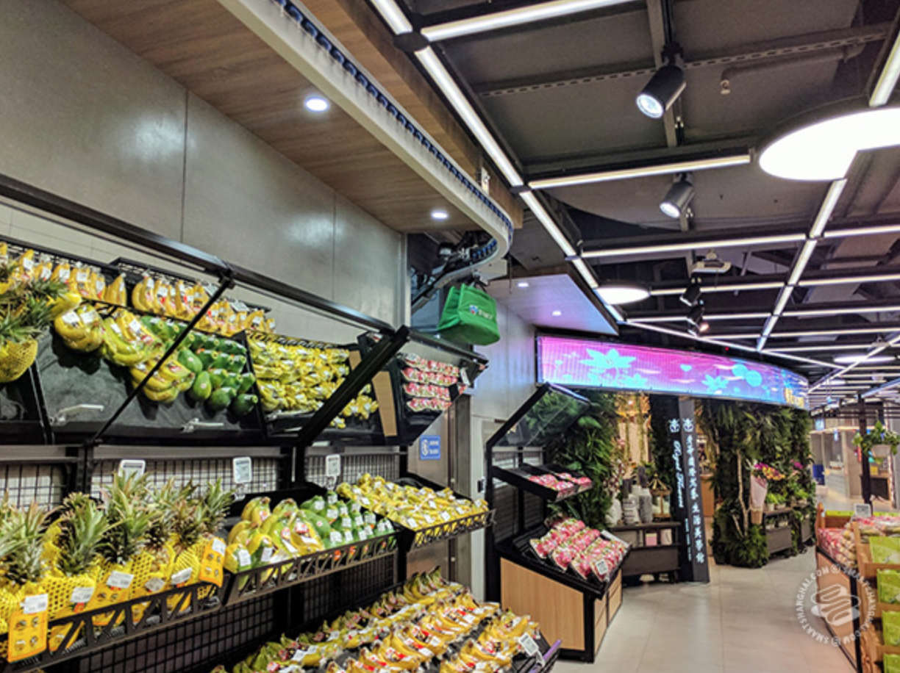
Hema Market (盒马集市)

Slide 57
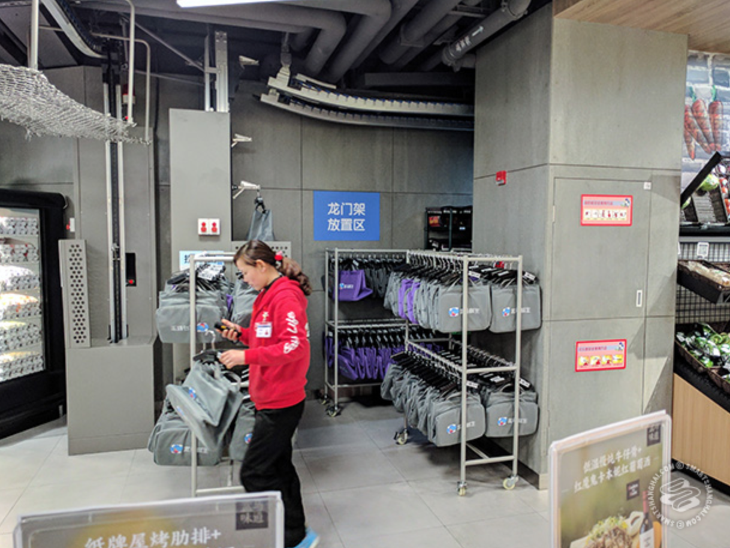
Hema Market (盒马集市)

Slide 58
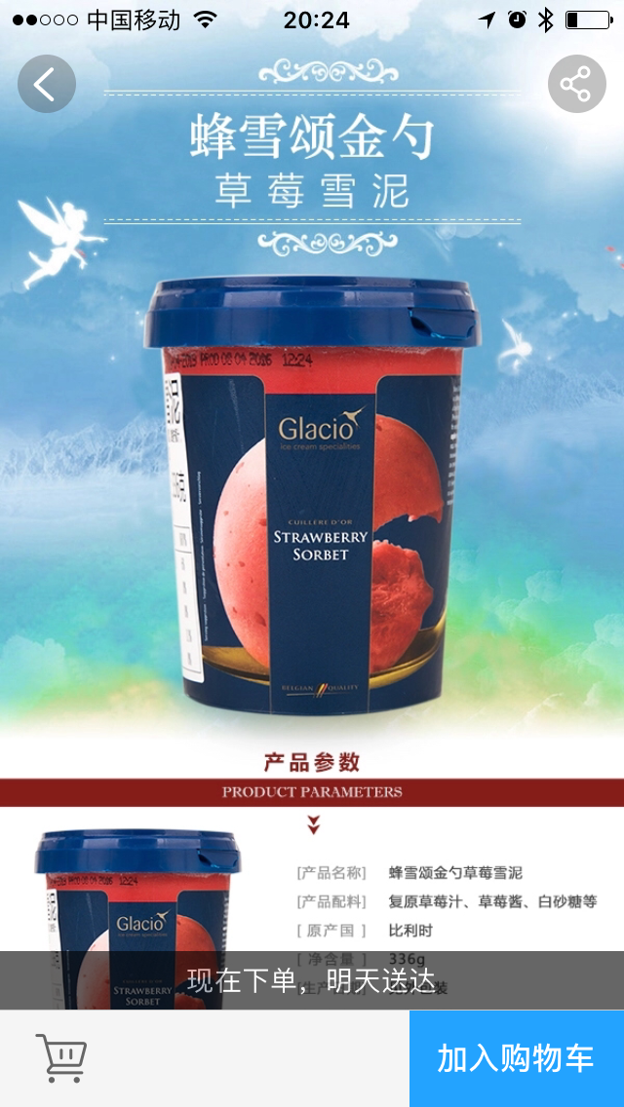
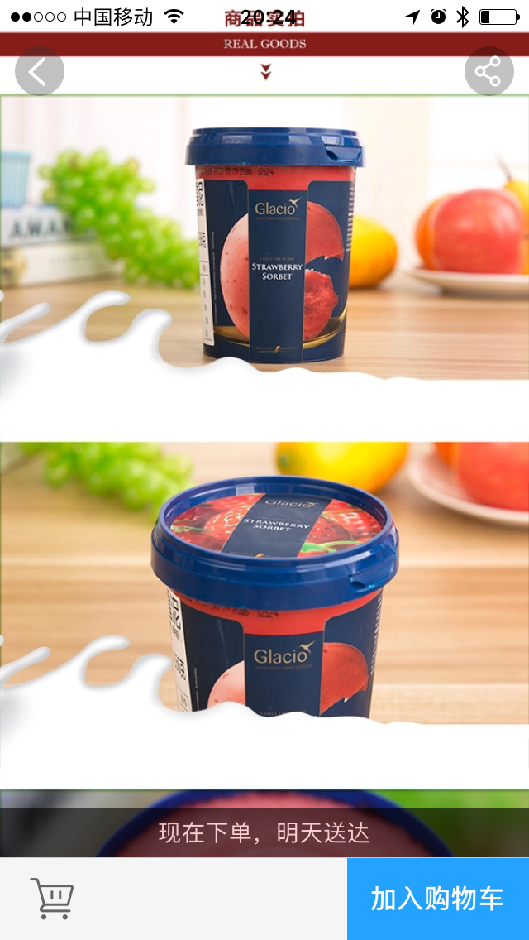
Glacio Ice Cream at Hema Market

Slide 59
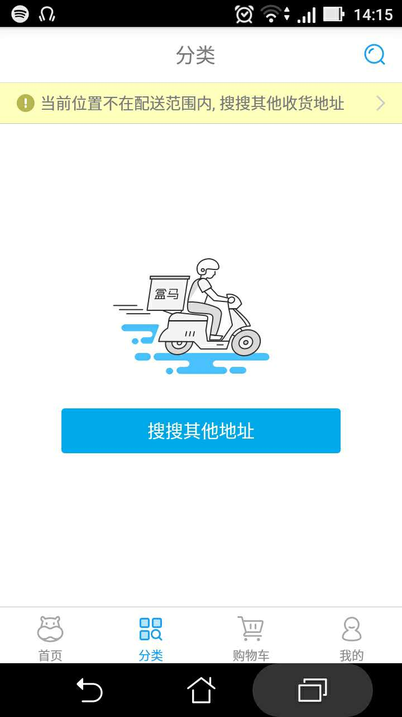
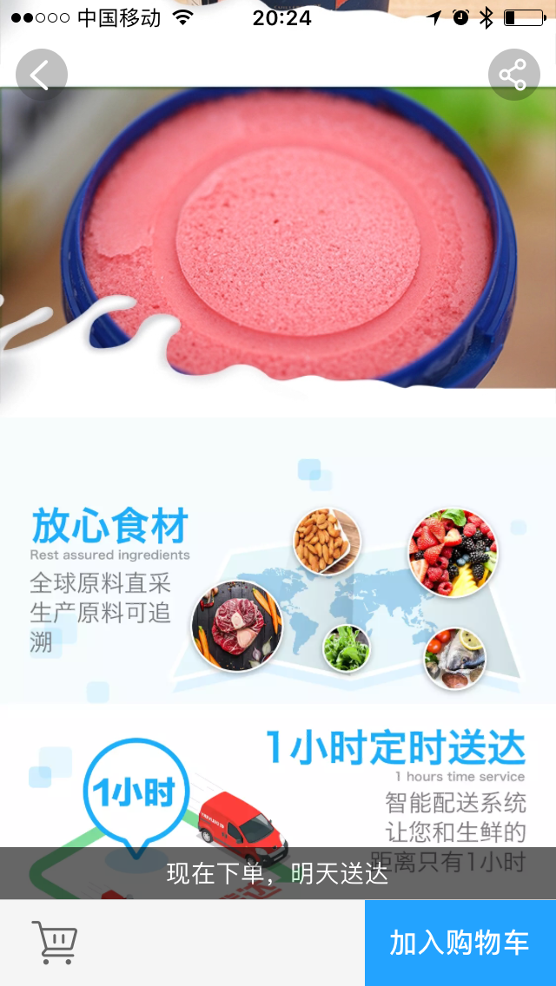
Glacio Ice Cream at Hema Market

Slide 60

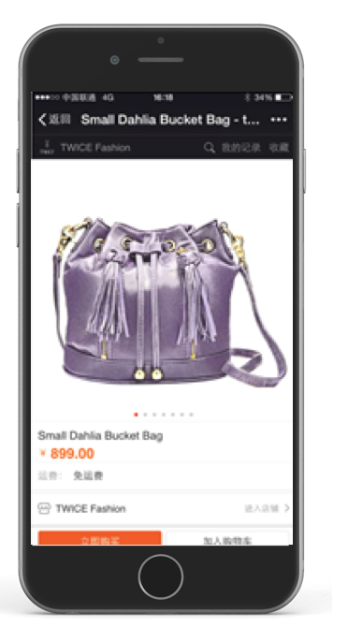
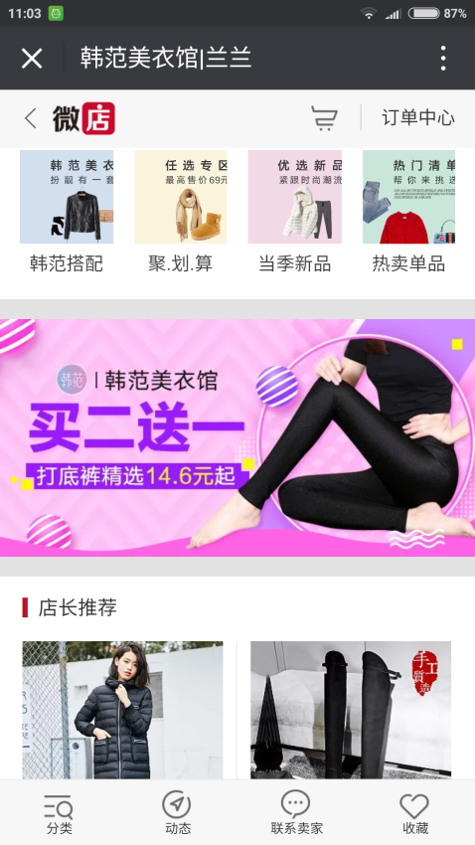
WeChat Store

Slide 61
Case Studies

Slide 62
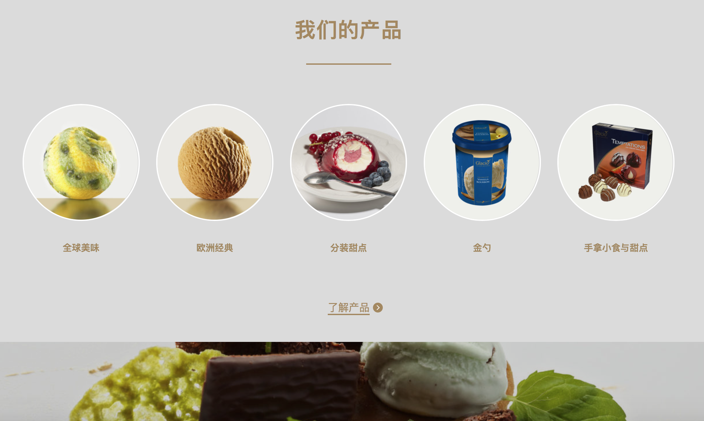
Glacio Chinese website

Slide 63

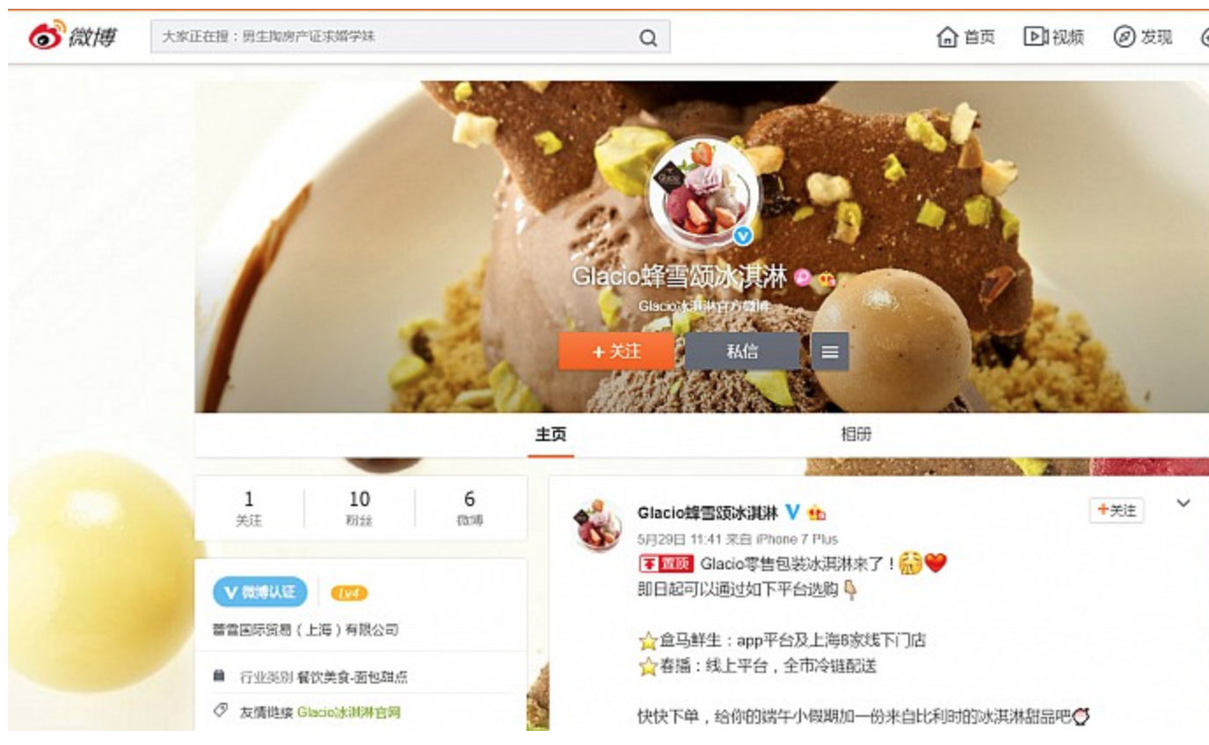
Glacio Weibo account

Slide 64
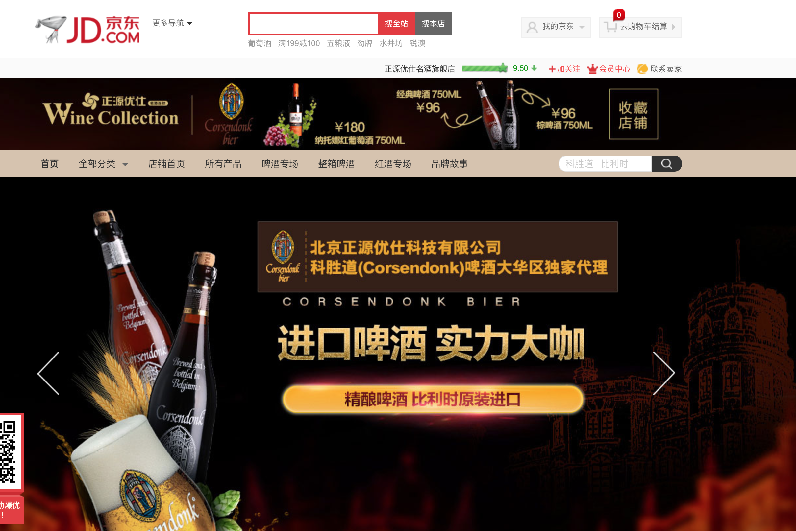
Corsendonk Beer
Flagship store on
JD.com

Slide 65
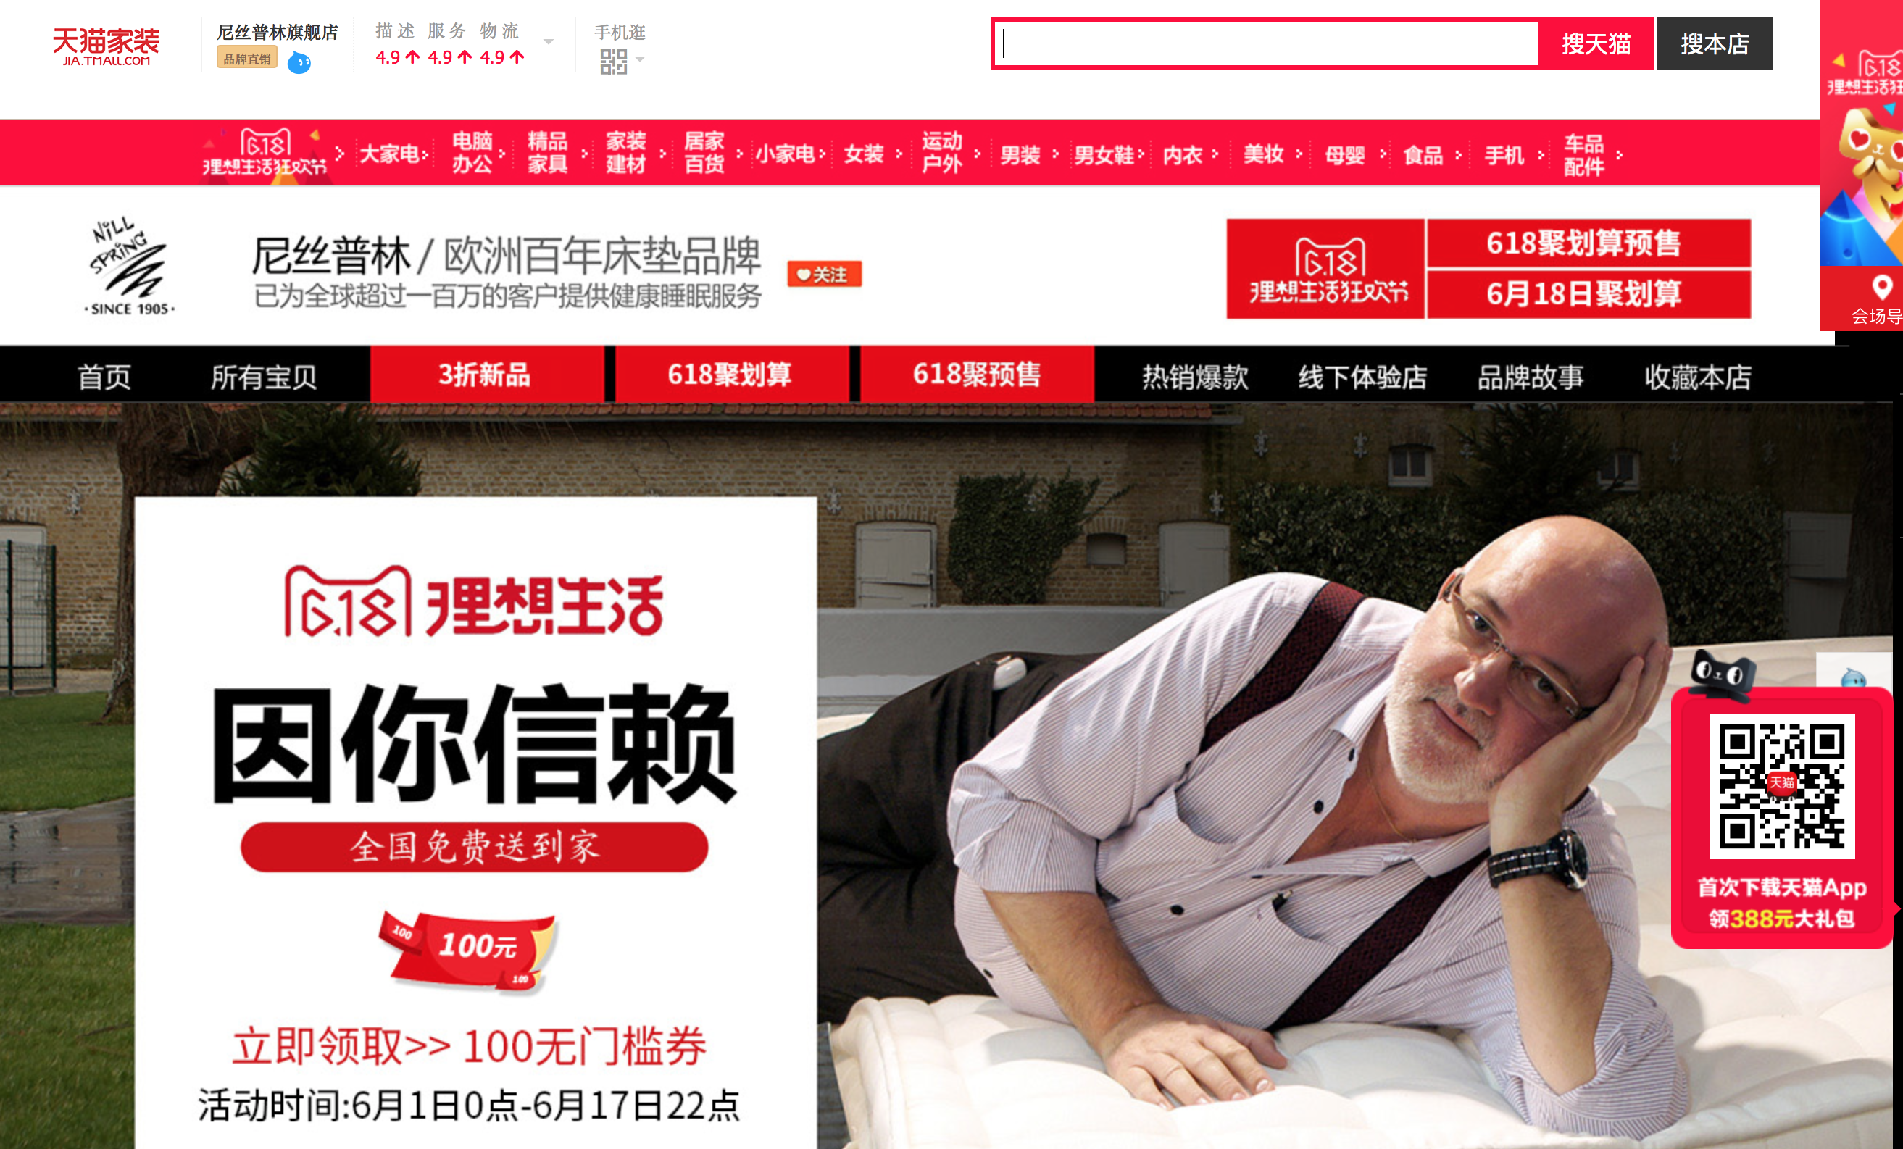
Nillspring Mattresses
Flagship store on
Tmall

Slide 66
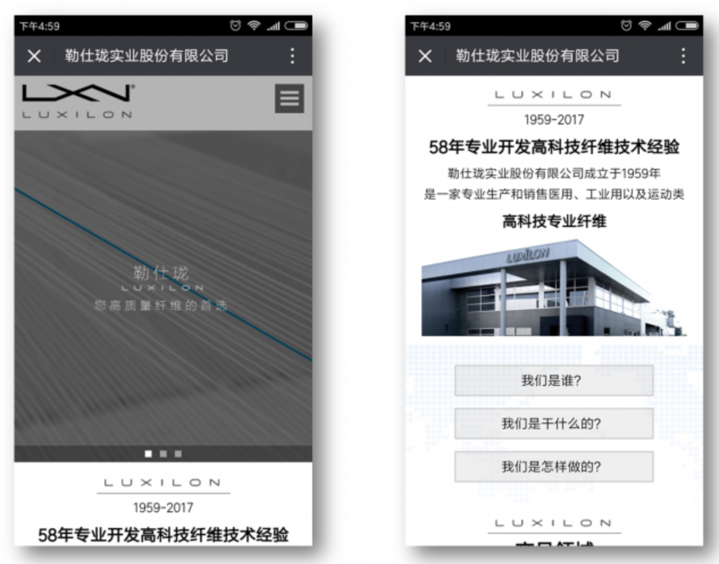
Luxilon WeChat page

Slide 67
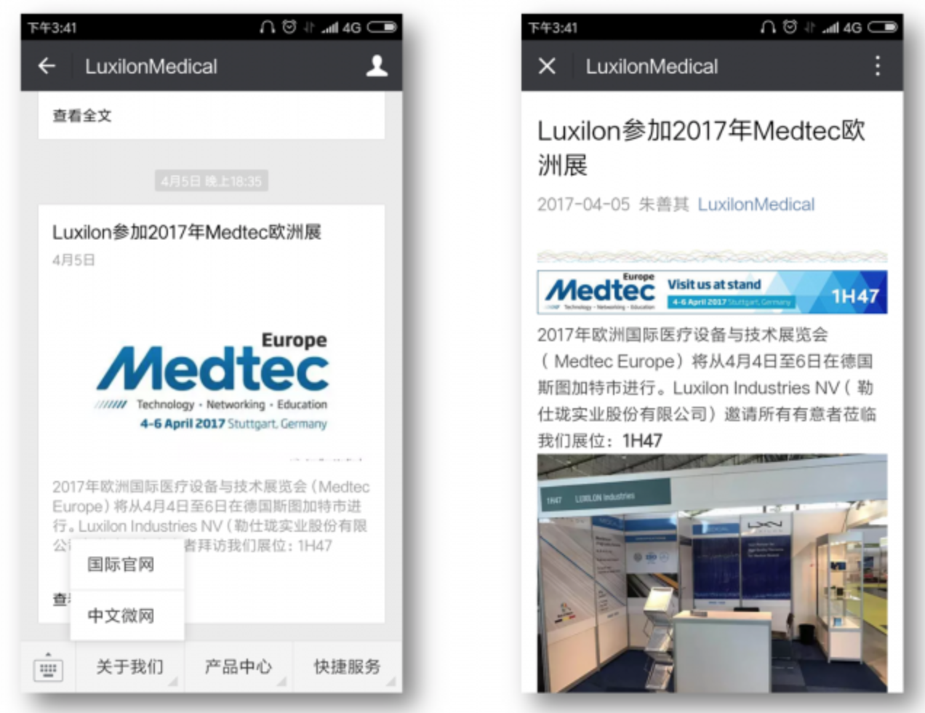
Luxilon WeChat page

Slide 68
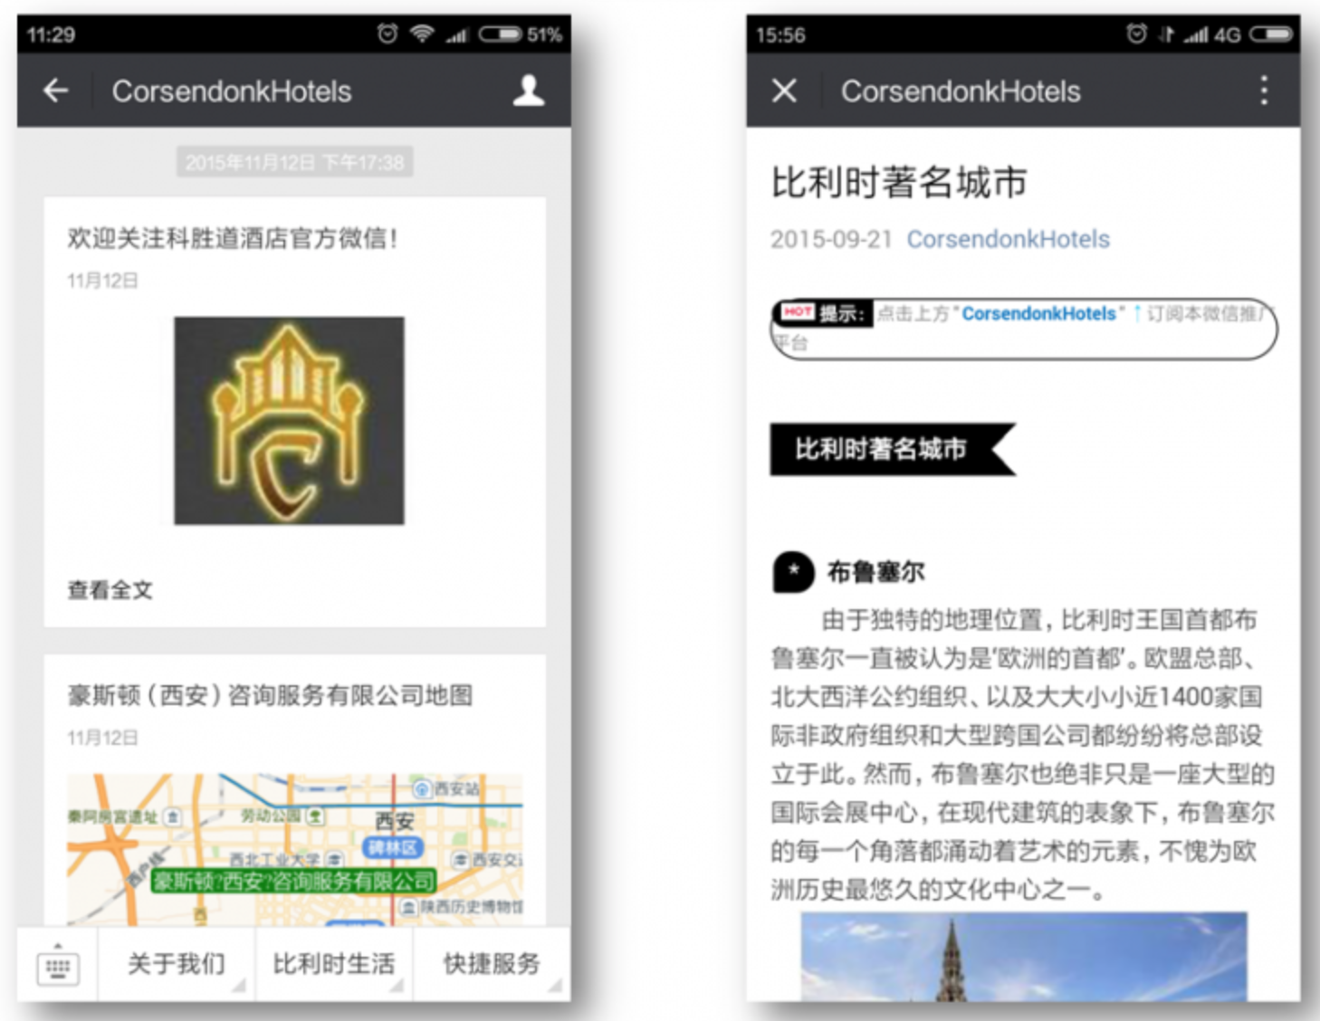
Corsendonk Hotels WeChat page

Slide 69
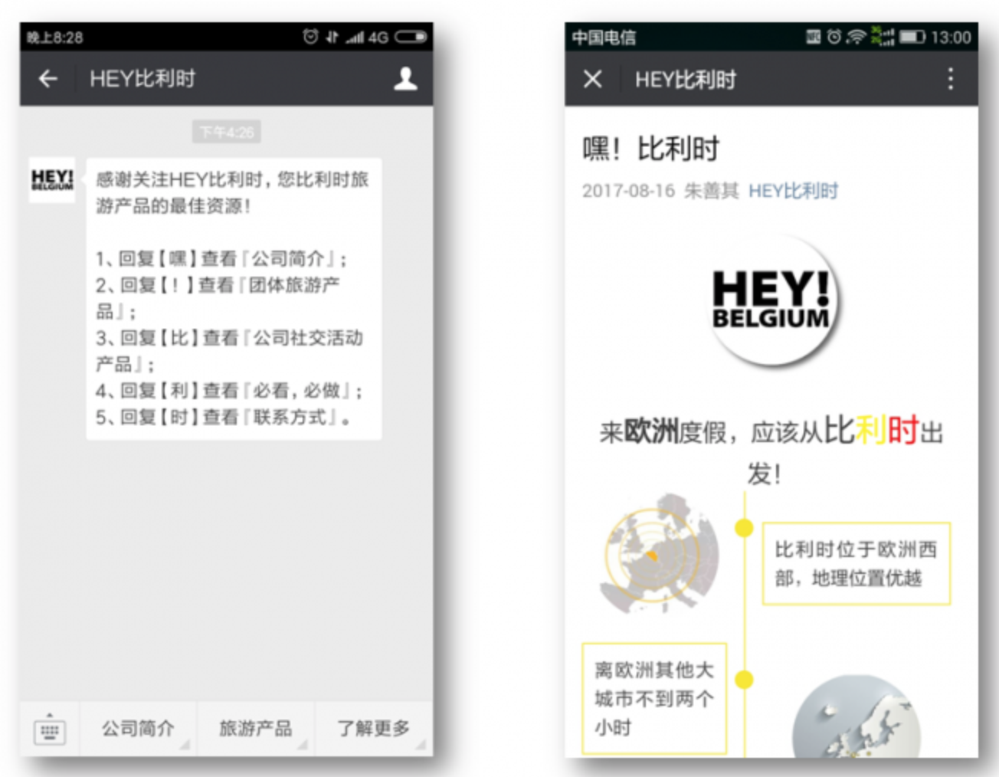
Hey!Belgium WeChat page

Slide 70

www.horsten.be
www.mychinaweb.com
Steenweg op Mol 129
B-2360 Oud-Turnhout
Belgium
Tel: +32 (0)14 720275
E-mail: info@horsten.be

