Slide 1
2004
【How to grow your business in China?
HOW TO GROW YOUR BUSINESS IN CHINA
Sven Agten
10/17/2017

Slide 2
【How to grow your business in China?
A PRODUCT OF CHINA
WHO AM I
A PRODUCT OF CHINA
WHO AM I
In since since 2004
Working for German multinational
Since 2004 in China
Working for a German multinational
Author
The Good, the Bad and the Ugly

Slide 3
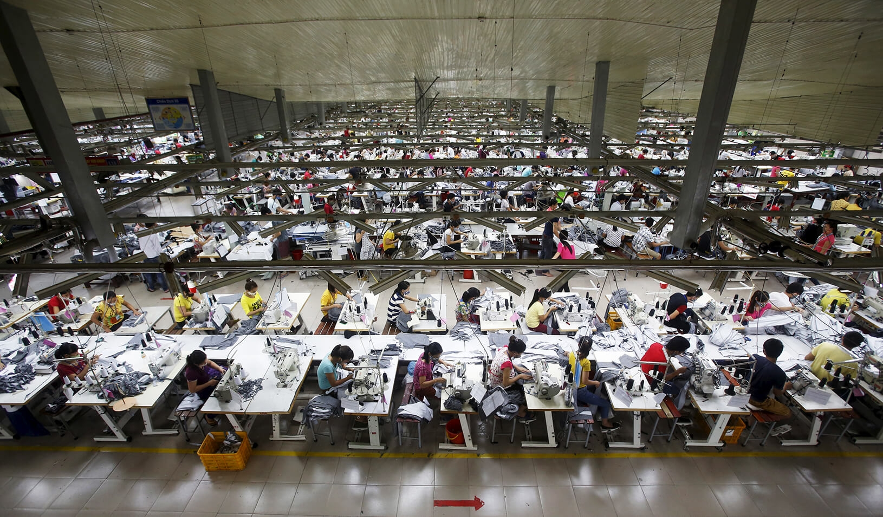
2004
【How to grow your business in China?

Slide 4
2017
【How to grow your business in China?

Slide 5
2004
【How to grow your business in China?
Why China keeps growing
What sectors in China are growing
How to grow my business in China

Slide 6
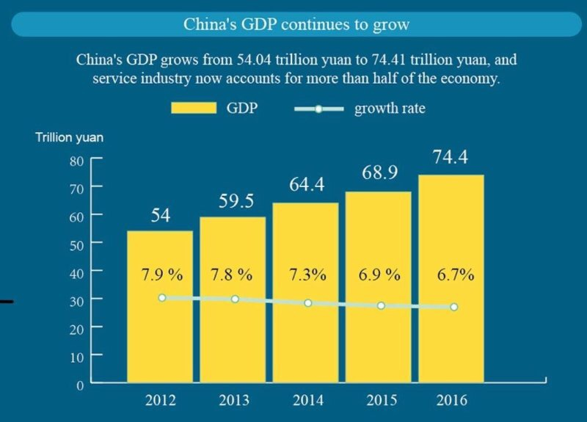
【How to grow your business in China?

Slide 7
【How to grow your business in China?
A. ECONOMIC CYCLE
Made in China
Made in China for China
To be in China, for China
Why China keeps growing

Slide 8
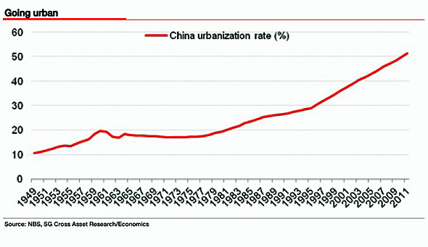
【How to make it in China?

Slide 9
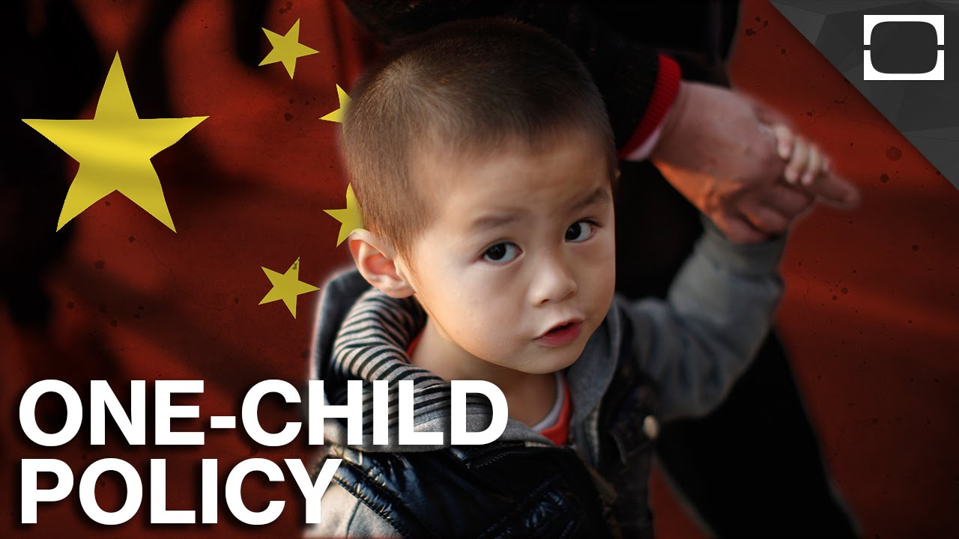
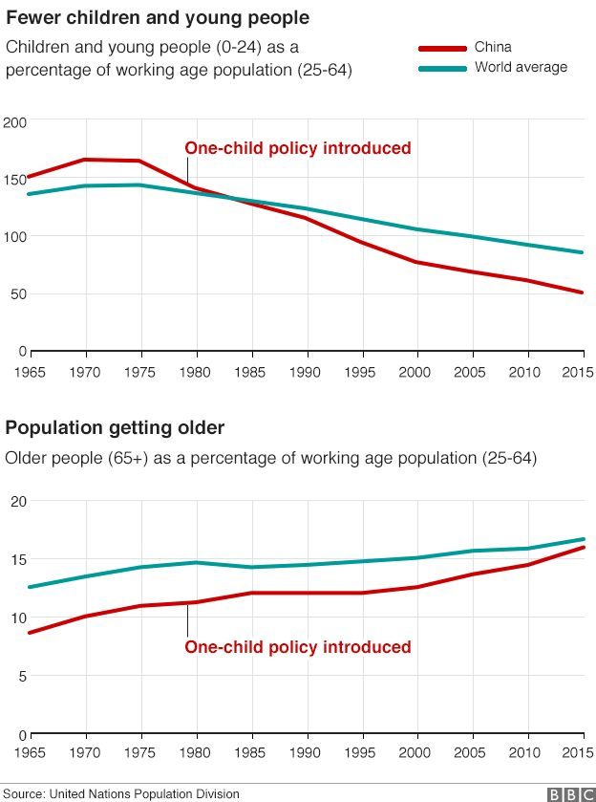
【How to grow your business in China?

Slide 10
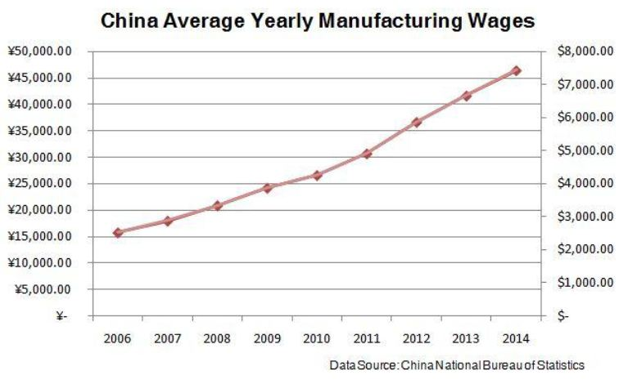
Made in China is not cheap anymore
【How to grow your business in China?

Slide 11
Made in China, for China
【How to grow your business in China?

Slide 12
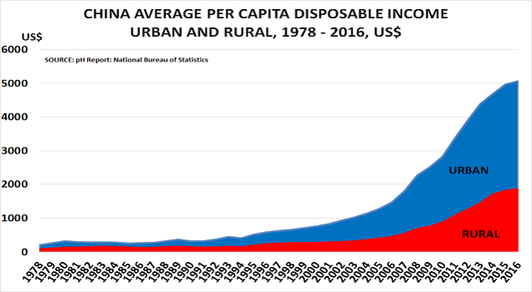
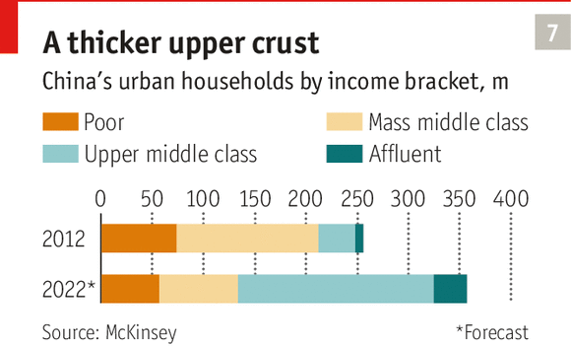
【How to grow your business in China?

Slide 13
【How to grow your business in China?
To be in China, for China
$28 billion
2000: R&D Chinese companies
$396 billion
2016: R&D Chinese companies

Slide 14
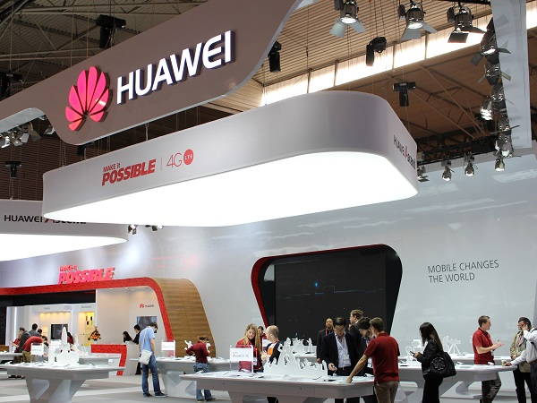
【How to grow your business in China?

Slide 15
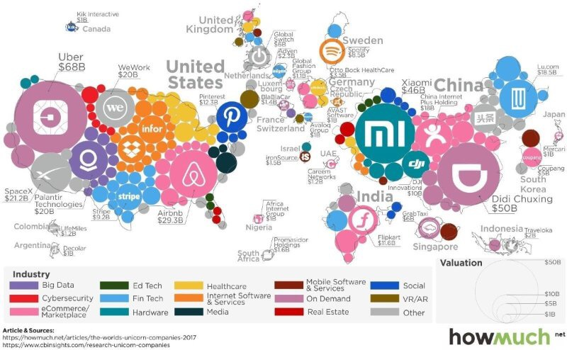
【How to grow your business it in China?

Slide 16
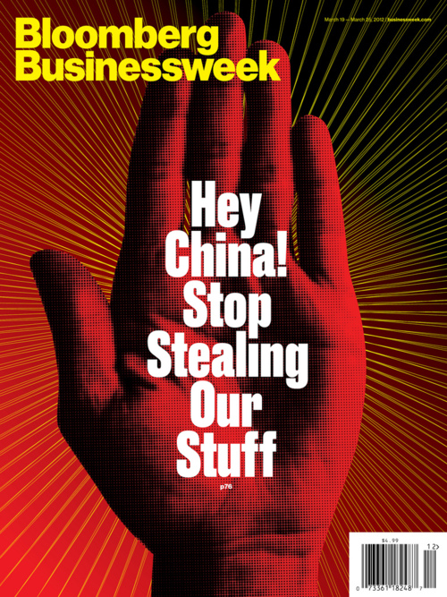
【How to grow your business in China?

Slide 17
【How to grow your business in China?
Why China keeps growing
B. URBANISATION & INFRASTRUCTURE

Slide 18
【How to grow your business in China?

Slide 19
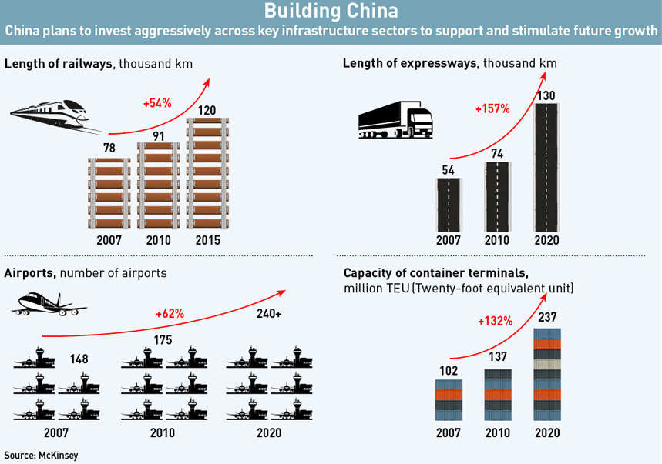
【How to grow your business in China?

Slide 20
【How to grow your business in China?
Why China keeps growing
C. CHINA INVESTS IN THE SECTORS THAT MATTER FOR THE NEXT 30 YEARS

Slide 21
【How to grow your business in China?

Slide 22
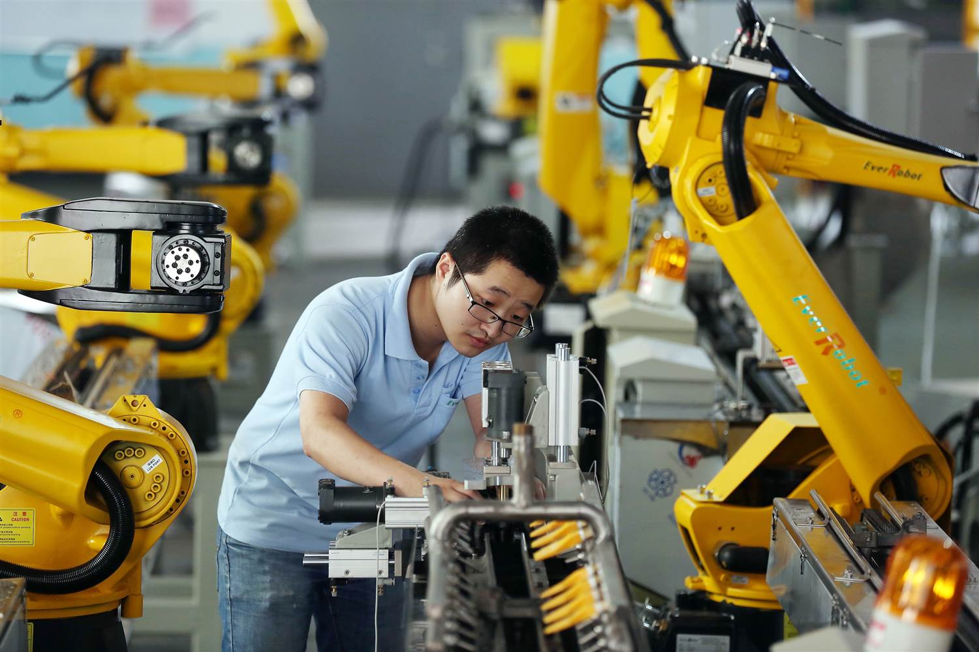
【How to grow your business in China?

Slide 23
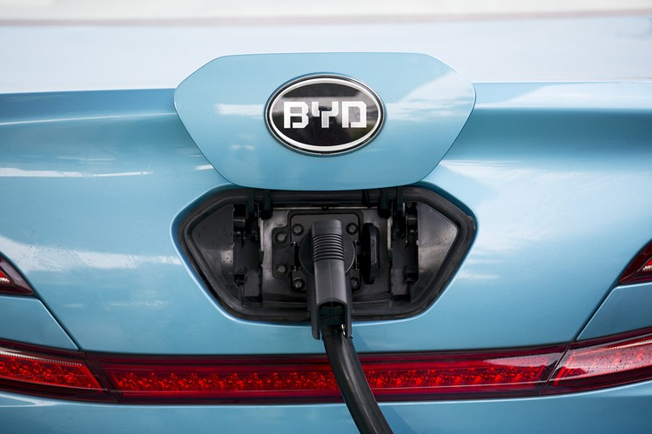
【How to grow your business in China?

Slide 24
【How to grow your business in China?

Slide 25
【How to grow your business in China?
What sectors in China are growing
A. MIDDLE CLASS DRIVEN
High Quality
Lifestyle

Slide 26
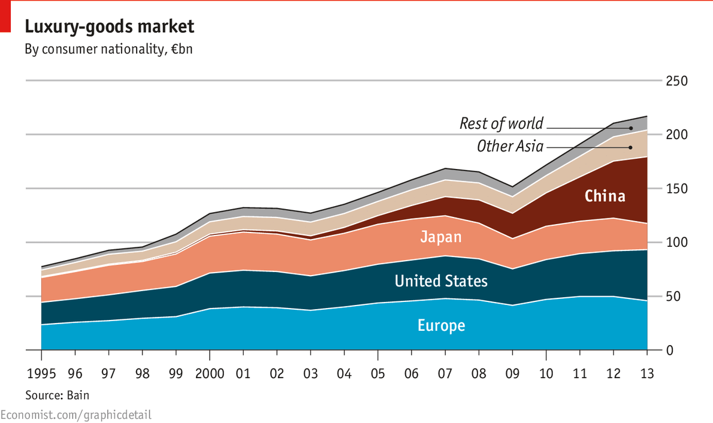
【How to grow your business in China?

Slide 27
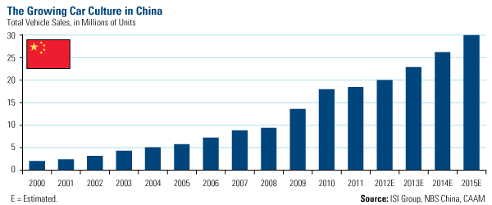
【How to grow your business in China?

Slide 28
【How to grow your business in China?

Slide 29
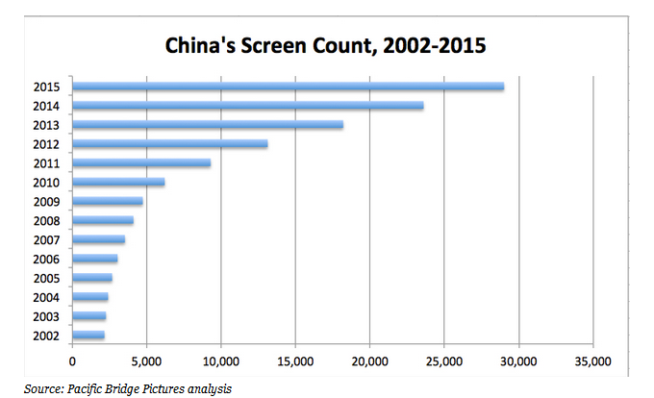
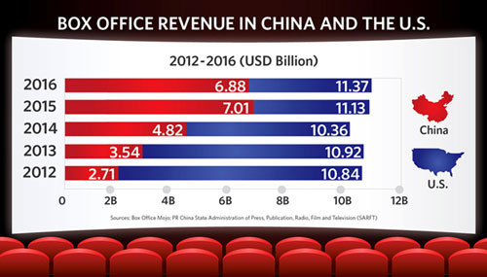
【How to make it in China?

Slide 30
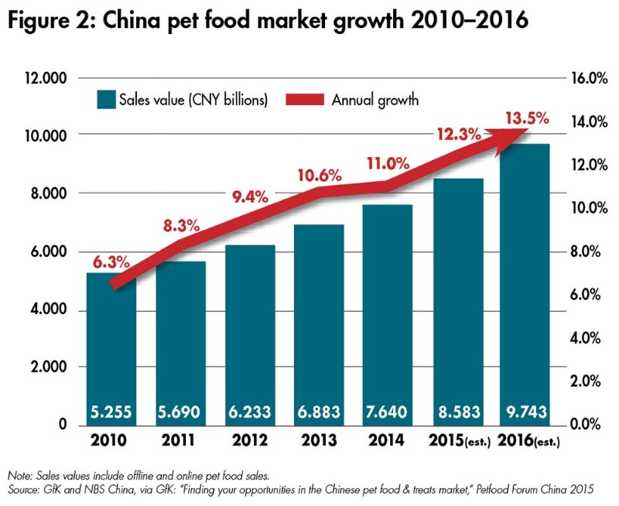
【How to grow your business in China?

Slide 31
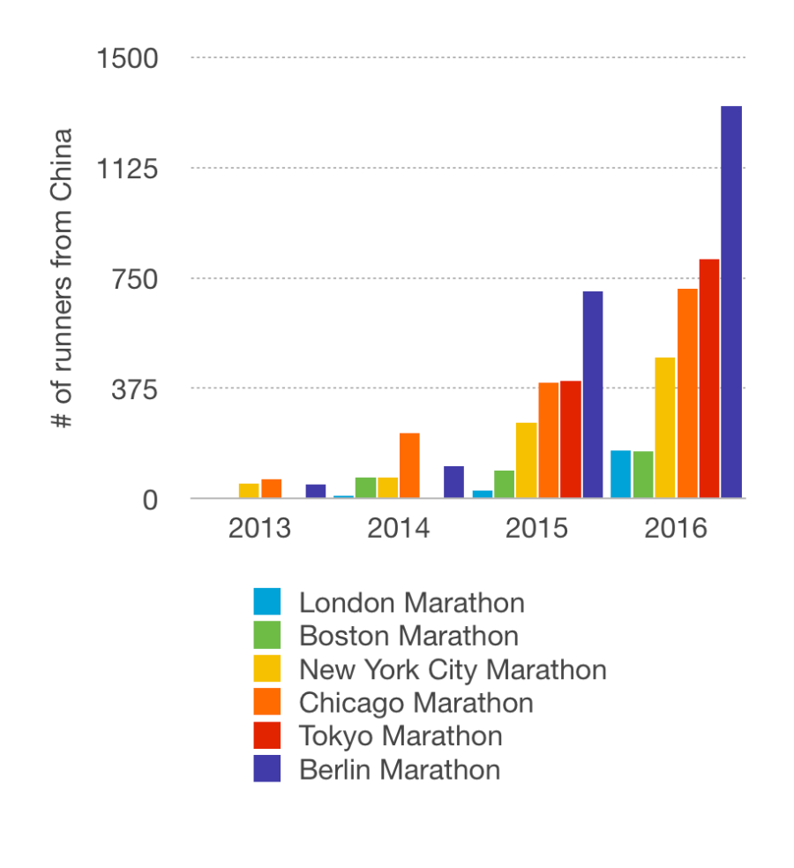
【How to grow your business in China?

Slide 32
【How to grow your business in China?
What sectors in China are growing
B. WHERE ARE THE PROBLEMS
What affects daily life?

Slide 33
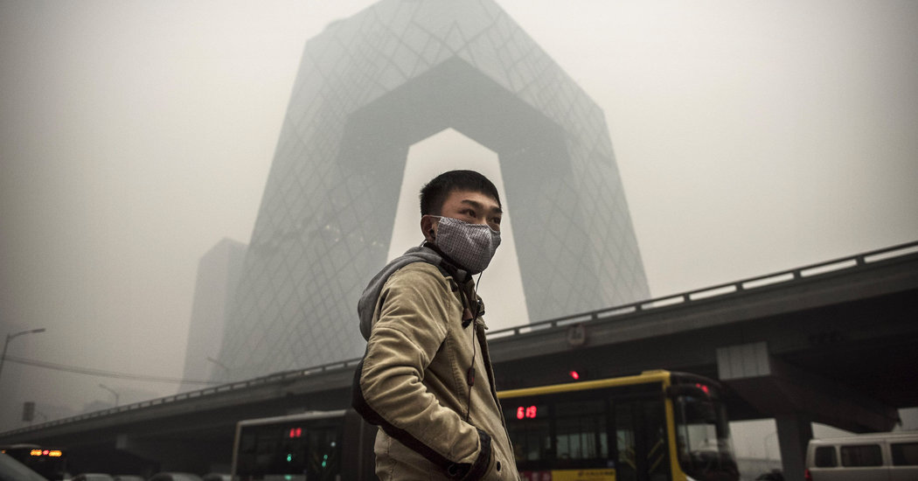
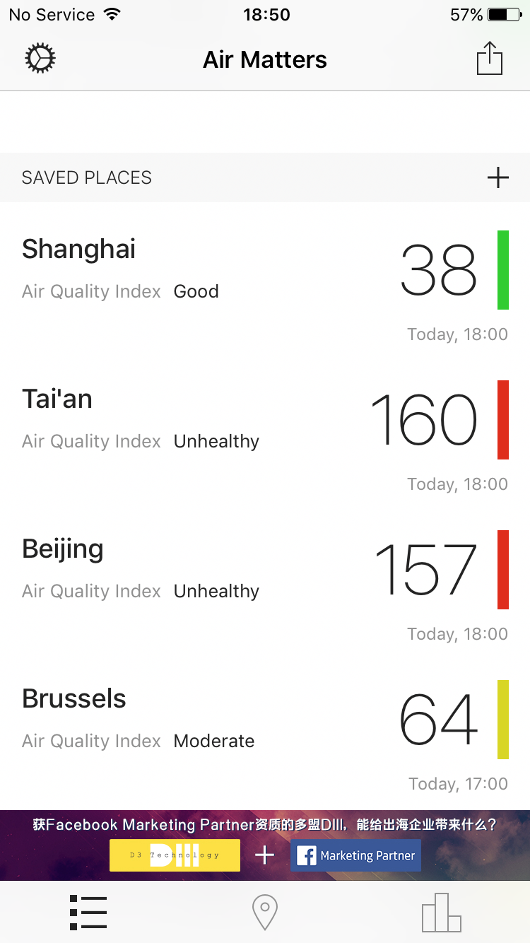
【How to grow your business in China?

Slide 34
【How to grow your business in China?

Slide 35
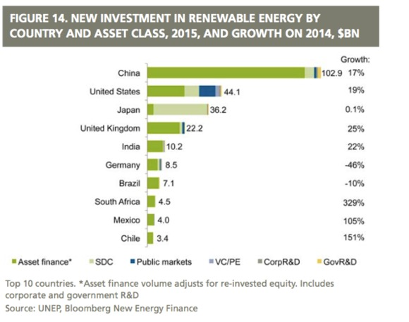
【How to grow your business in China?

Slide 36
【How to grow your business in China?

Slide 37
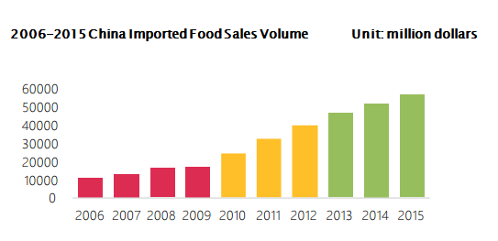
【How to make it in China?

Slide 38
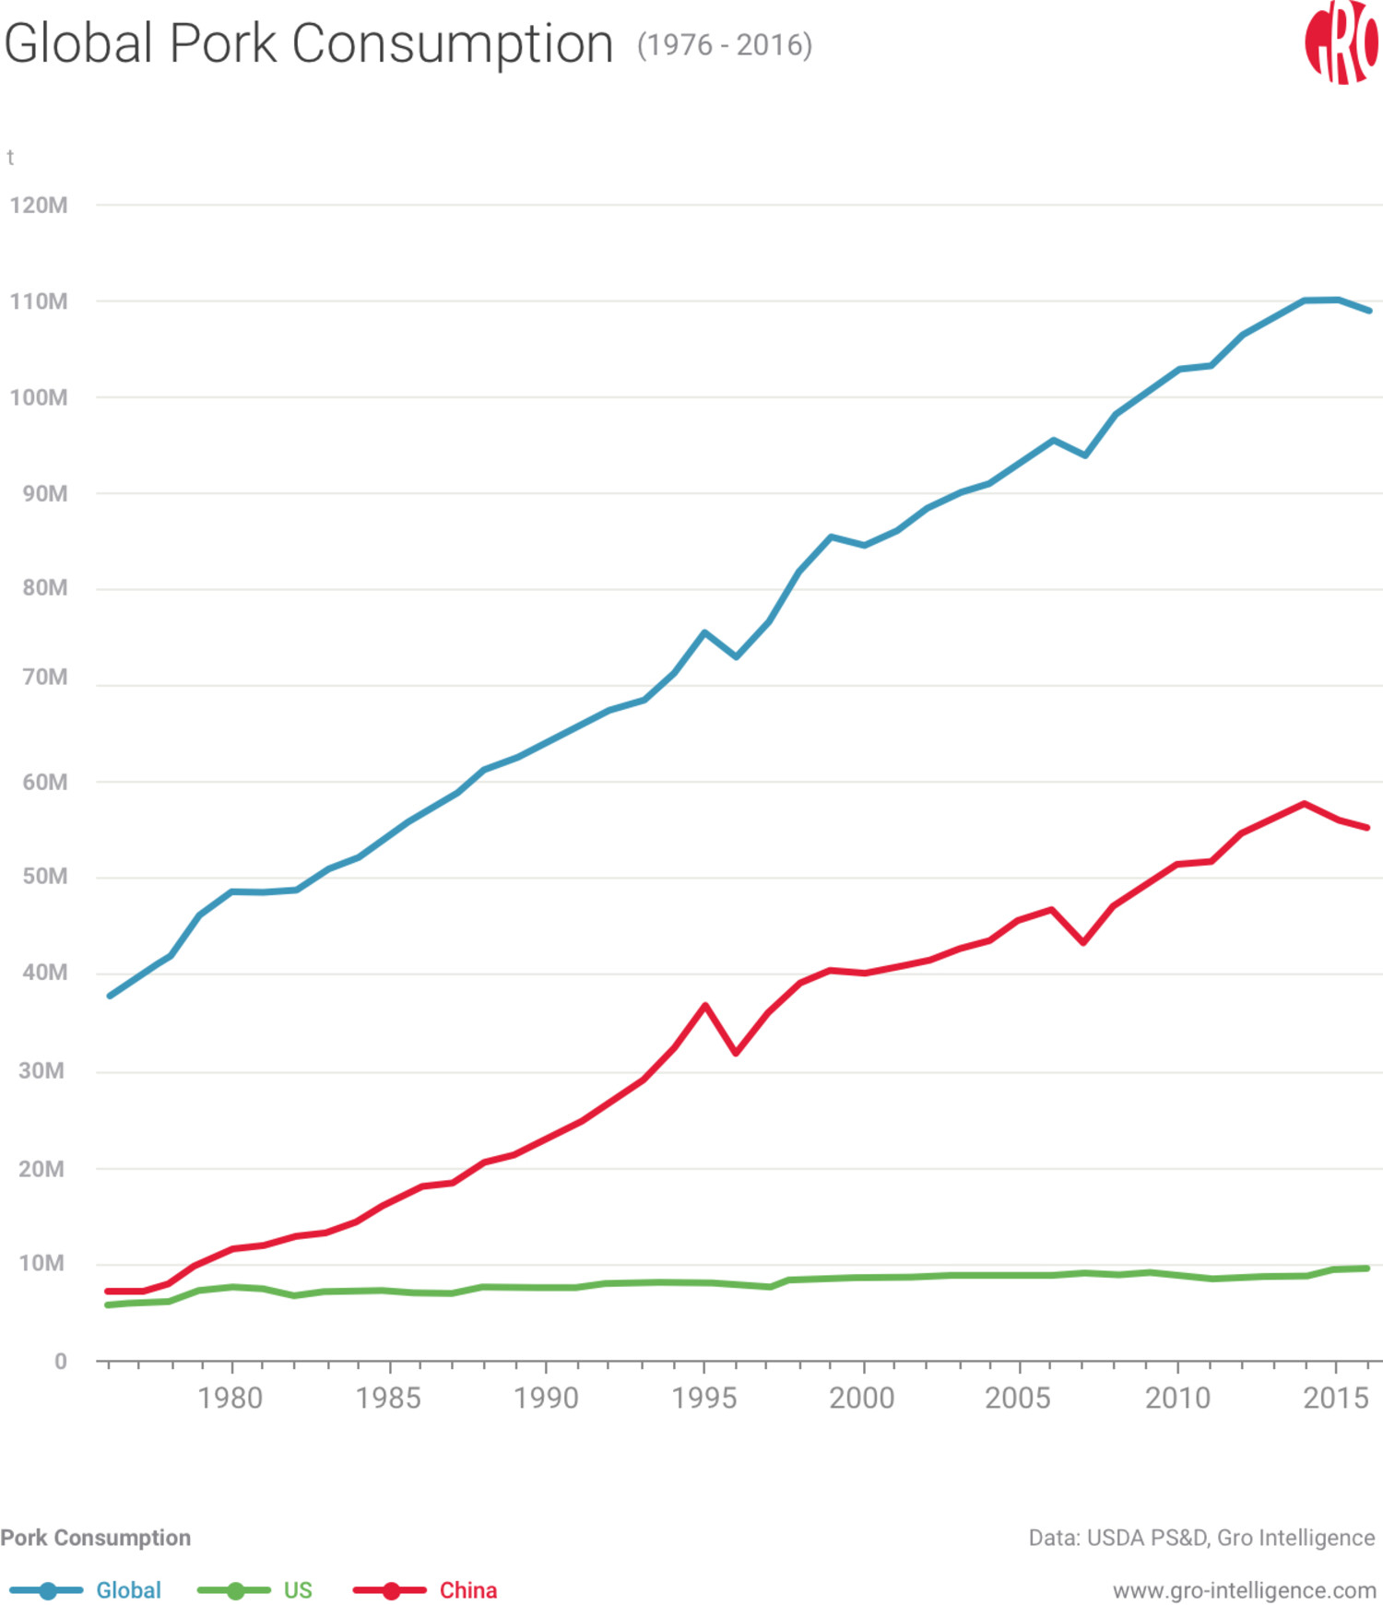
【How to make it in China?

Slide 39
【How to grow your business in China?

Slide 40
【How to grow your business China?

Slide 41
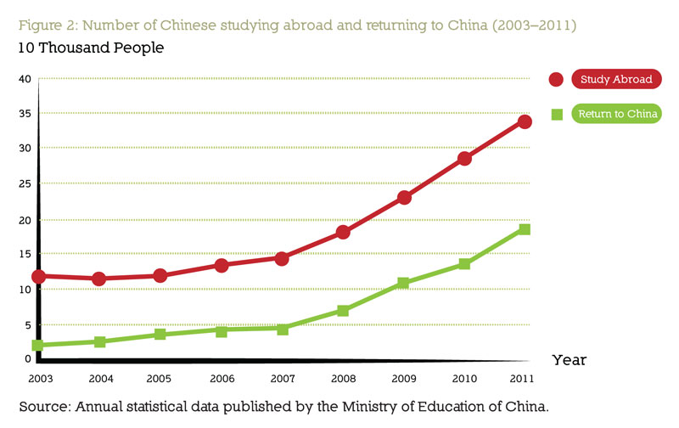
【How to make it in China?

Slide 42
【How to grow your business in China?
What sectors in China are growing
C. WHAT MAKES LIFE CONVENIENT
Internet & Digitalization

Slide 43
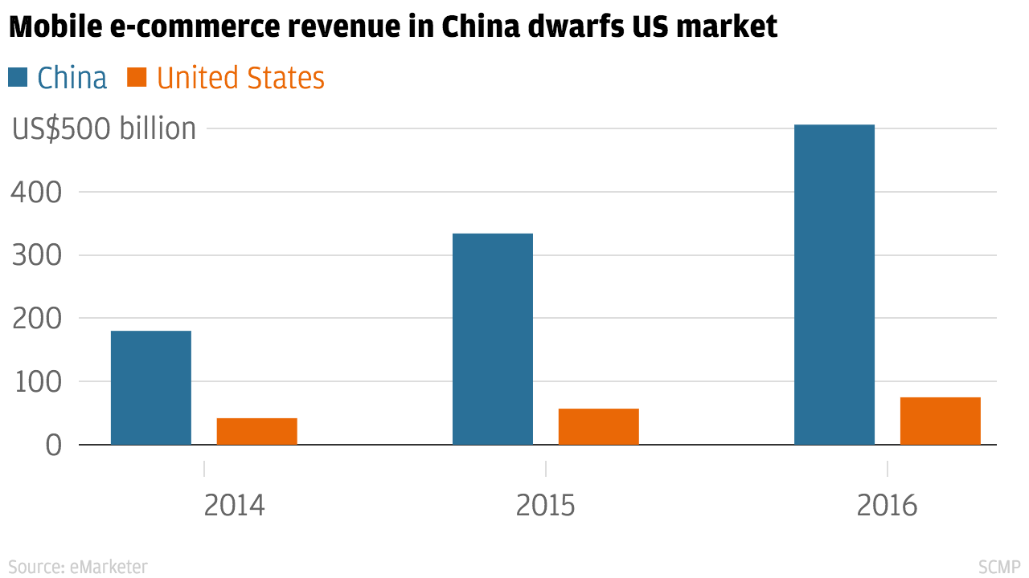
【How to grow your business it in China
2016 China internet users: 730 million
2016 China Mobile phone users: 1.3 billion
95% of internet users use mobile phone to go online
95% of internet users have purchased online

Slide 44
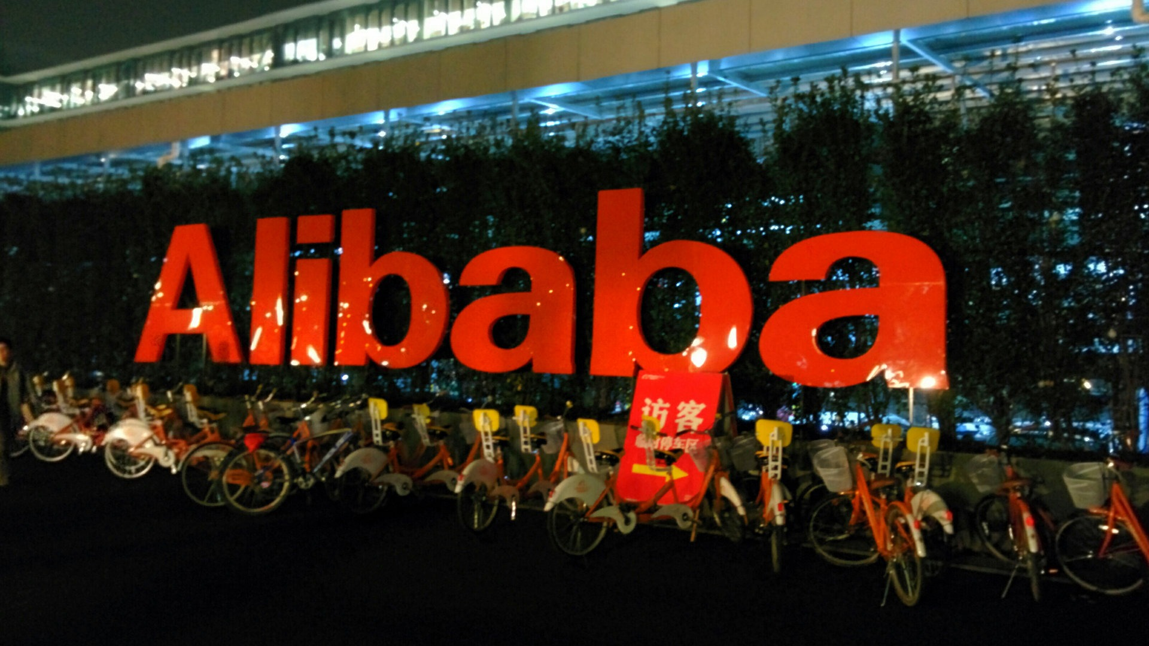
【How to make it in China?

Slide 45
【How to grow your business in China?
How to grow your business in China
A. Act fast to grow fast
Competition is immense
Business cycles go fast
Implement fast

Slide 46
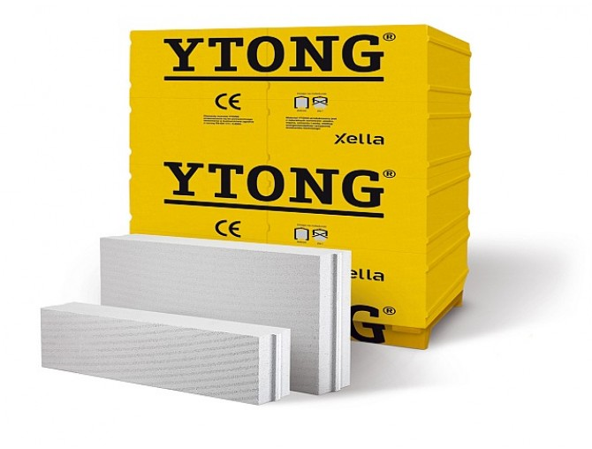
【How to grow your business in China?
´In the past 12 months, as many as 58,250 new consumer products have hit the shelves in China’s mainland´ (160 per day)
2.000 competitors in China

Slide 47
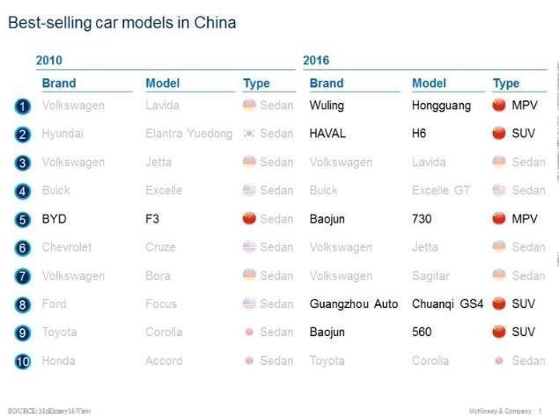
【How to grow your business in China?

Slide 48
【How to grow your business in China?
How to grow your business in China
B. Know your customer
The Chinese Millennial
International
Tech savvy
Willing to try everything

Slide 49
【How to to grow your business in China?

Slide 50
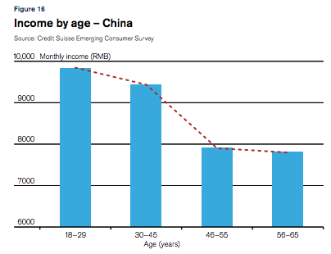
【How to grow your business in China?

Slide 51
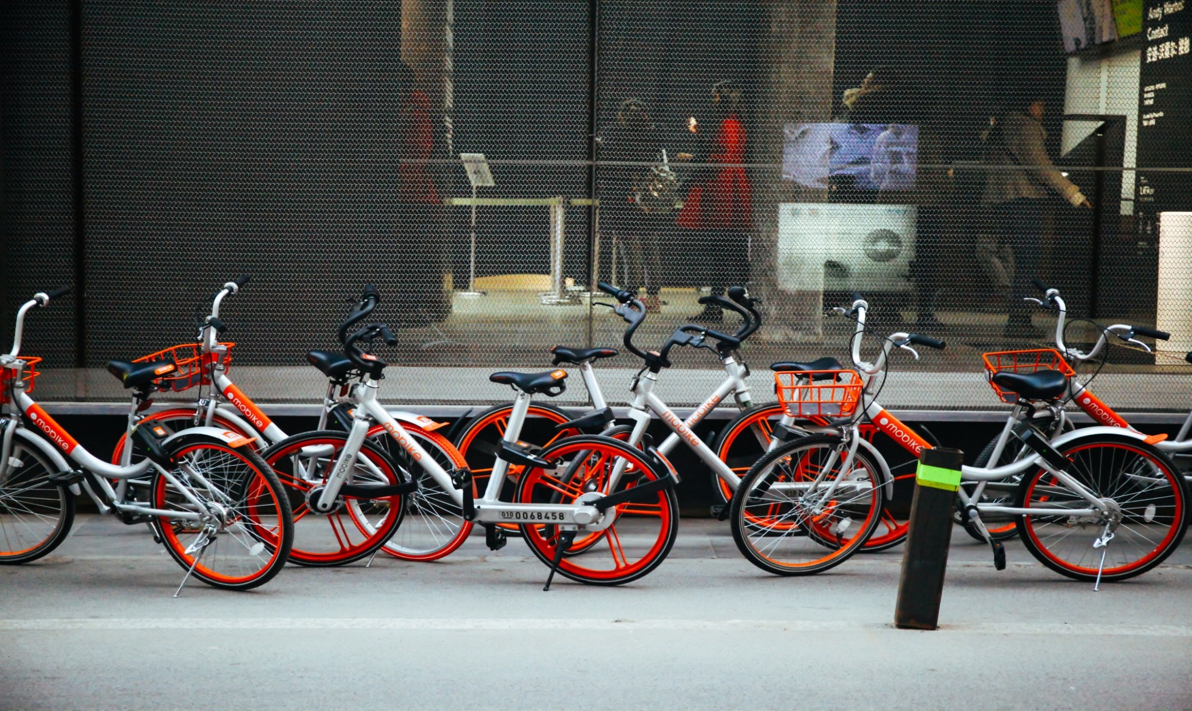
【How to grow your business in China?

Slide 52
【How to grow your business in China?
How to grow your business in China
C. Know your competitor
Ambitious
Warrior of many wars
Used to hardship

Slide 53
【How to grow your business in China?

Slide 54
【How to grow your business in China?
How to grow your business in China
D. Life is work
Networking
Lean & Agile
Day and Night

Slide 55
【How to grow your business in China?

Slide 56
【How to grow your business in China?

Slide 57
【How to grow your business in China?
How to grow your business in China
E. Localization in every aspect
Marketing & Communication
Sales
Products
Services

Slide 58
【How to grow your business in China?

Slide 59
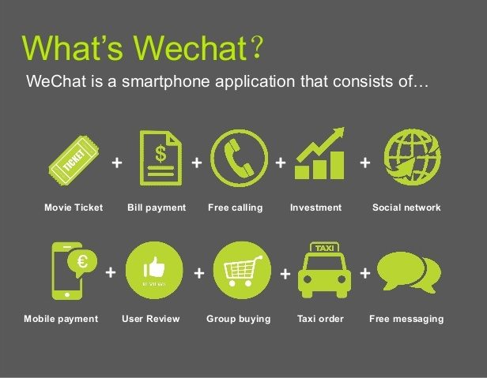
【Hoew to grow your businessi in China?

Slide 60
【How to grow your business in China?

Slide 61
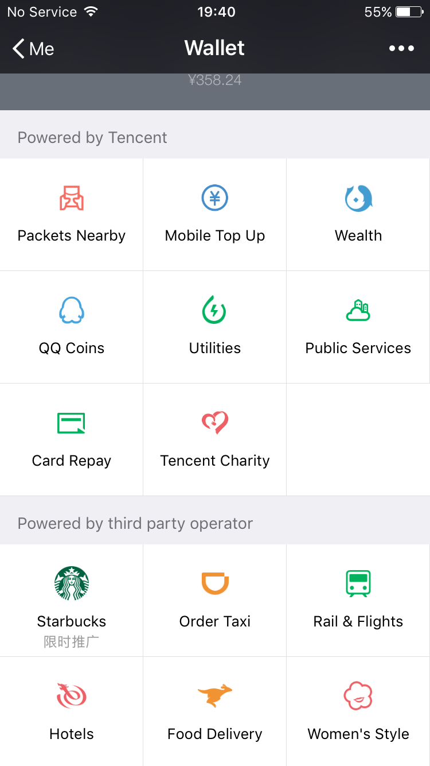
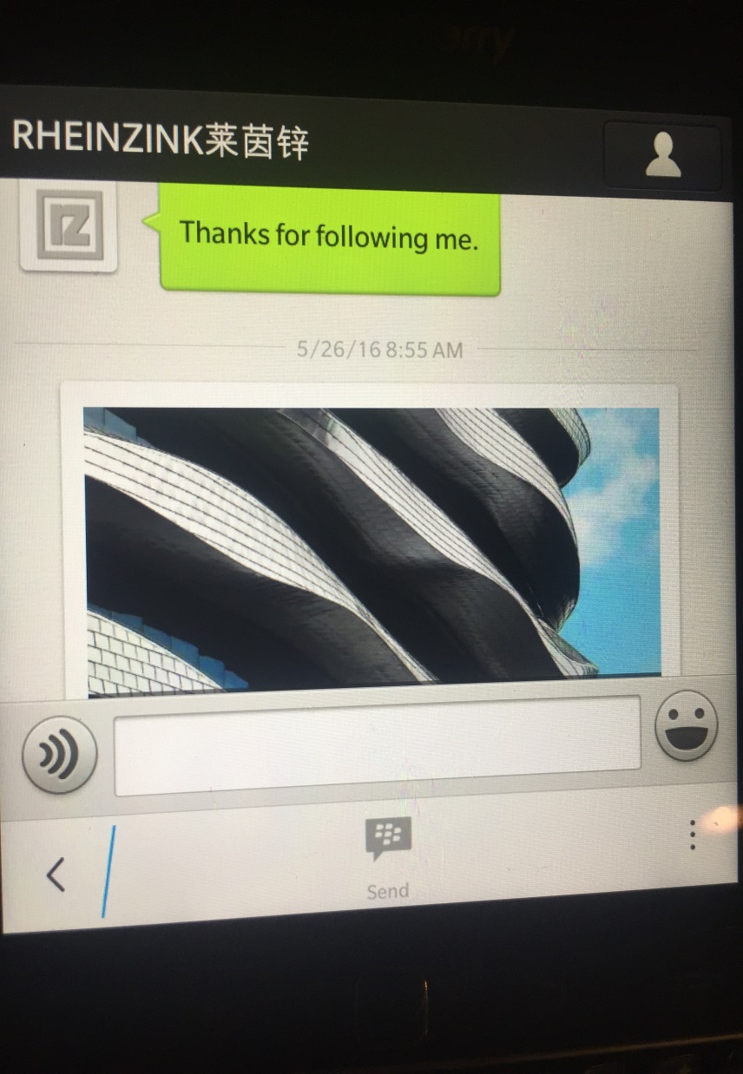
【How to grow your business in China?

Slide 62
【How to grow your business in China?

Slide 63
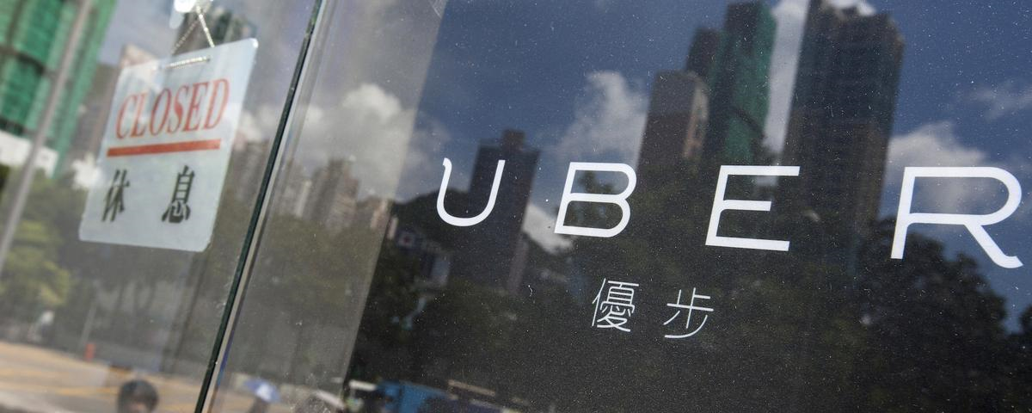
【How to grow your business in China?

Slide 64
【How to grow your business in China?
How to grow your business in China
F. The Chinese perspective
You are in China
Your customers are Chinese
Your staff is Chinese

Slide 65
【How to grow your business it in China?

Slide 66
2004
【How to grow your business in China?
THANK YOU

